Slide 1
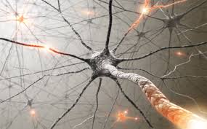
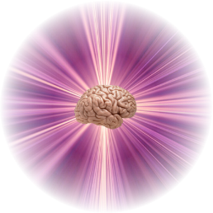
Fast Neural Network Adaptation with Associative Pulsing Neurons
Adrian Horzyk
horzyk@agh.edu.pl
Google: Horzyk
Janusz A. Starzyk
starzykj@ohio.edu
Google: Janusz Starzyk
AGH University of
Science and Technology
Krakow, Poland
Ohio University, Athens, Ohio, U.S.A., School of Electrical Engineering and Computer Science
University of Information Technology and Management, Rzeszow, Poland

Slide 2
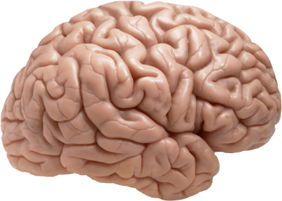
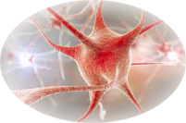
Brains and Neurons
How do real neurons work?

Slide 3
Brains and Neurons
execute internal processes in parallel and often asynchronously
use time approach for temporal and contextual computations
integrate the memory with the procedures
How do real neurons work?

Slide 4
Brains and Neurons
associate data and objects automatically and context-sensitively
self-organize and aggregate representation of similar input data
use a complex graph memory structure built from neurons
How do real neurons work?

Slide 5
Brains and Neurons
use time approach for temporal and contextual computations
are not limited by the Turing machine computational model
automatically restore the resting states of neurons
How do real neurons work?

Slide 6
Brains and Neurons
associate various pieces of information forming knowledge
aggregate representation of the same or close objects
self-organize and connect associated objects
How do real neurons work?

Slide 7
Fundamental Question of Neuroscience
How is information encoded and decoded by a series of pulses forwarded by neurons after action potentials?
The fundamental question of neuroscience is to determine whether neurons communicate by a rate of pulses or temporal differences between pulses?
Associative Pulsing Neurons show that the passage of time between subsequent stimuli and their frequency substantially influence the results of neural computations and associations.
How do real neurons work?

Slide 8
Objectives and Contribution
Implementation of associative self-organizing mechanisms inspired by brains which speed up and simplify functional aspects of spiking neurons.
Introduction of a new associative pulsing model of neurons that can quickly point out related data and entities and be used for inference.
Construction of neural networks implementing associative spiking mechanisms of neurons and conditional plasticity.

Slide 9
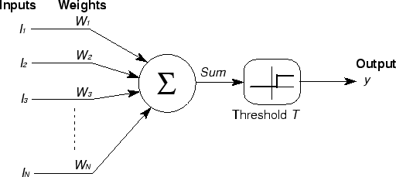
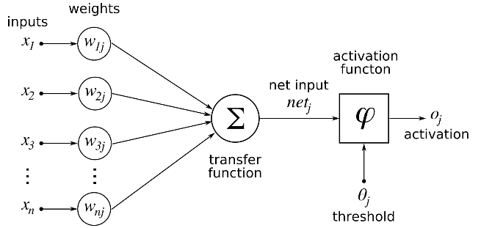
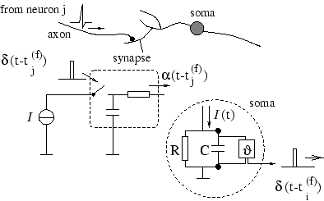
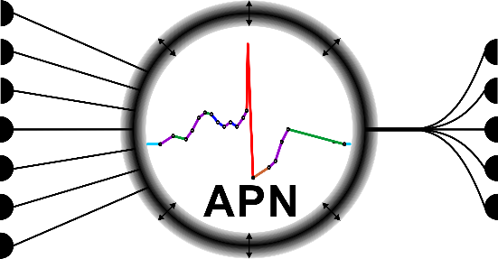
Neuron Models Evolution
GENERATIONS OF NEURON MODELS:
The McCulloch-Pitts model of neurons implements only the most fundamental mechanism of weighted input stimuli integration and threshold activation function leaving aside issues of time, plasticity and other factors.
The model of neurons using non-linear continuous activation functions enables us to build multilayer neural networks (e.g. MLP) and adapt such networks to more complex tasks.
The spiking models of neurons enriched this model with the implementation of the approach of time which is very important during stimuli integration and subsequent processes modeling.
The associative pulsing models (APN) of neurons produce series of pulses (spikes) in time which frequency determines the association level. Moreover they enrich the model with automatic plastic mechanism which let neurons to conditionally connect and configure associative neural structures representing data, objects and their sequences.
Real neurons are plastic as well!
Notes:
„Given that the proposed approach intends to mimic human neuronal functioning, it would be nice that the authors elaborate on the physiological plausibility of their approach and the differences, in this sense, with the spiking neuron models.” [Reviewer]

Slide 10
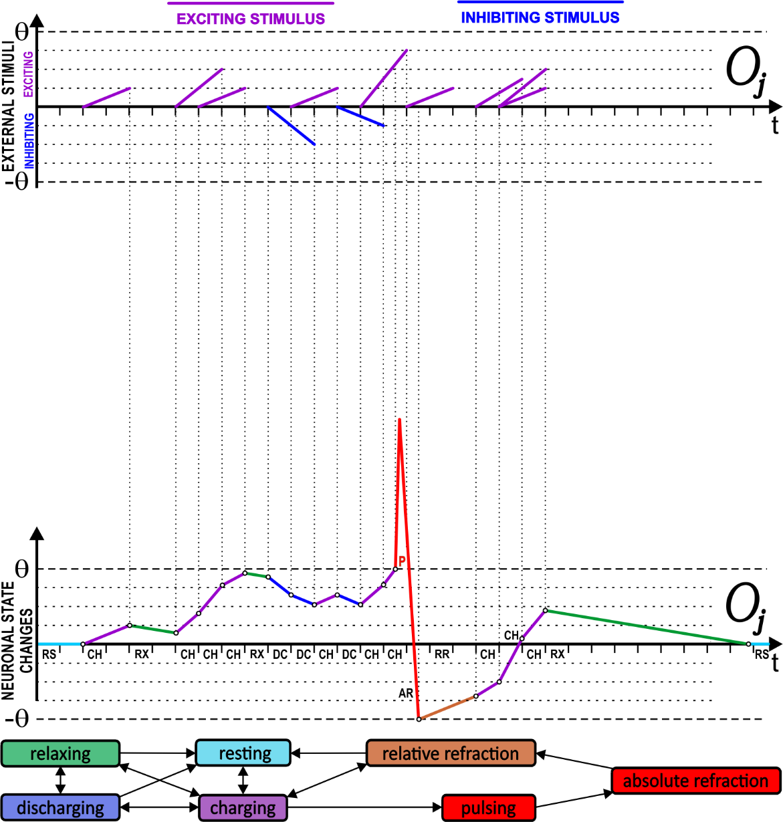
Associative Pulsing Neurons
Implement a new time-spread integration mechanism which quickly combines input stimuli in time producing an internal process queue (IPQ) of subsequent internal processes.
It allows for recalling of associated information.

Slide 11
Associative Pulsing Neurons
Model the internal processes of real neurons but allow for the update of their states in sparse discrete moments of time that is much more time-efficient than the continuous updating.
It allows for recalling of associated information.

Slide 12
Associative Pulsing Neurons
Implement plastic mechanisms of real neurons which allow for adaptive self-organization of the neuronal structure thanks to the conditional creation of connections between activated neurons, and for the association of the information encoded by these neurons.
It allows for recalling of associated information.

Slide 13
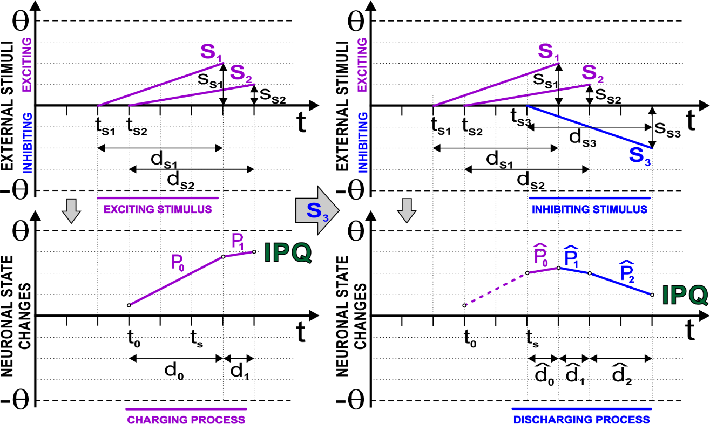
Combining of Input Stimuli
The stimulus S₂ occurs the APN internal state is updated.
The remaining part of S₁ is linearly combined with S₂ producing IPQ consisting of the processes: P₀-P₁
Creation of the queue of subsequent internal processes which do not overlap in time.

Slide 14
Combining of Input Stimuli
When the inhibiting stimulus S₃ comes the APN is updated again at the time when this stimulus occurs.
Next, this stimulus is linearly combined with the existing processes P₀-P₁ in the IPQ producing a new sequence of processes.
Creation of the queue of subsequent internal processes which do not overlap in time.

Slide 15
Global Event Queue
GEQ – Global Event Queue sorts and waits for moments when the first internal processes of all IPQs of neurons will finish because in these moments, the neuronal states must be updated and the internal processes must be switched to the subsequent ones.
Watching out the discrete update moments.

Slide 16
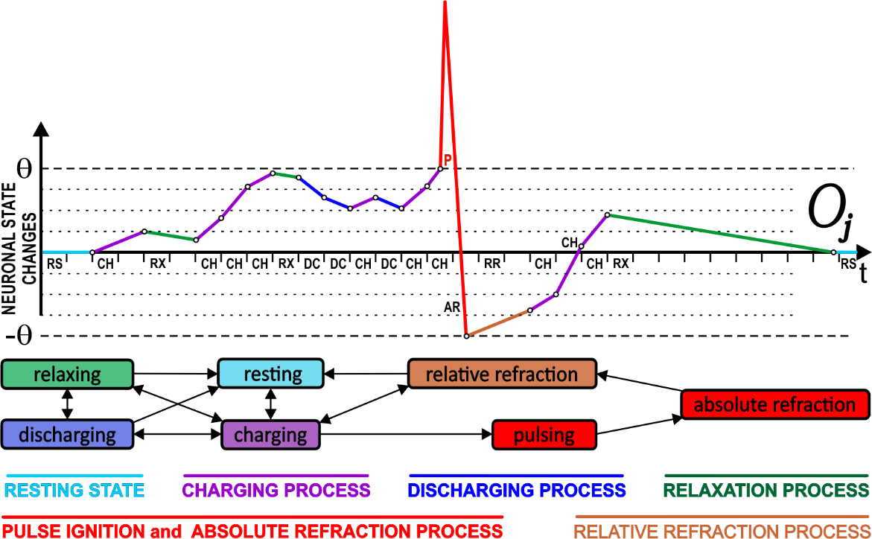
Pulsing Moments of APNs
GEQ – Global Event Queue also watches out the moments when the pulsing thresholds are achieved and when APNs should start pulsing.
GEQ watches out when the APNs achieve activation thresholds to make them pulsing.

Slide 17
Associative Pulsing Neurons
Conditionally connect and change their sensitivity to input stimuli.
Reproduce time activity of neurons in the neural structure.
Sparse connections reflect the time-spread relations between objects.
Aggregate representation of the same or similar objects presented to the neural network on the receptive sensory input fields (SIF).
Represent these combinations of input stimuli that make them firing, and according to their sensitivity, they can specialize over time.
It allows for recalling of associated information.

Slide 18
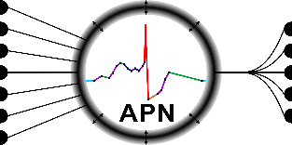
When APNs are created?
They are automatically created for receptors placed in the sensory input fields (SIFs) if no existing neuron reacts to their stimulation.
They can connect to one or many receptors according to the passage of time between the receptor stimulations.
They connect to other neurons if they fire in the close succession of time to reproduce the sequence of object occurrences.
They are not created if any of the existing neurons fires because it means that such a class of objects (combination of input stimuli) is already known and represented in the neural network.
Conditional creation and connection of neurons.

Slide 19
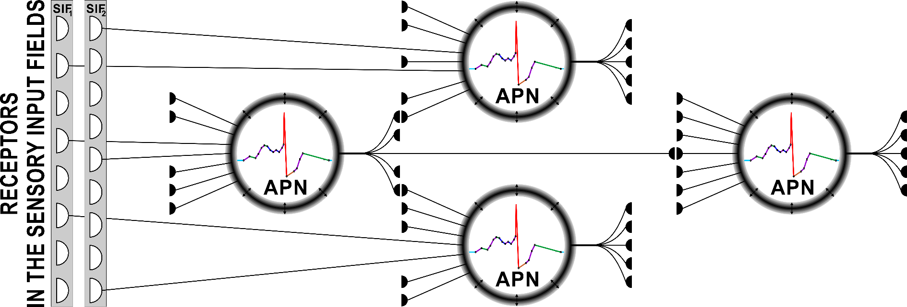
Connections and Synapses
Receptors of the SIFs are directly connected to APNs (no synapses).
Each receptor continuously stimulates the connected APN until the input stimulus influence on the SIF but the APN is updated in the discrete moments of time when the stimulus vanishes or charges the APN.
APNs are connected via synapses which have their weights coming from different synaptic permeability computed as a result of the synaptic efficiency of firing the postsynaptic neuron.
Plastic conditional connections.

Slide 20
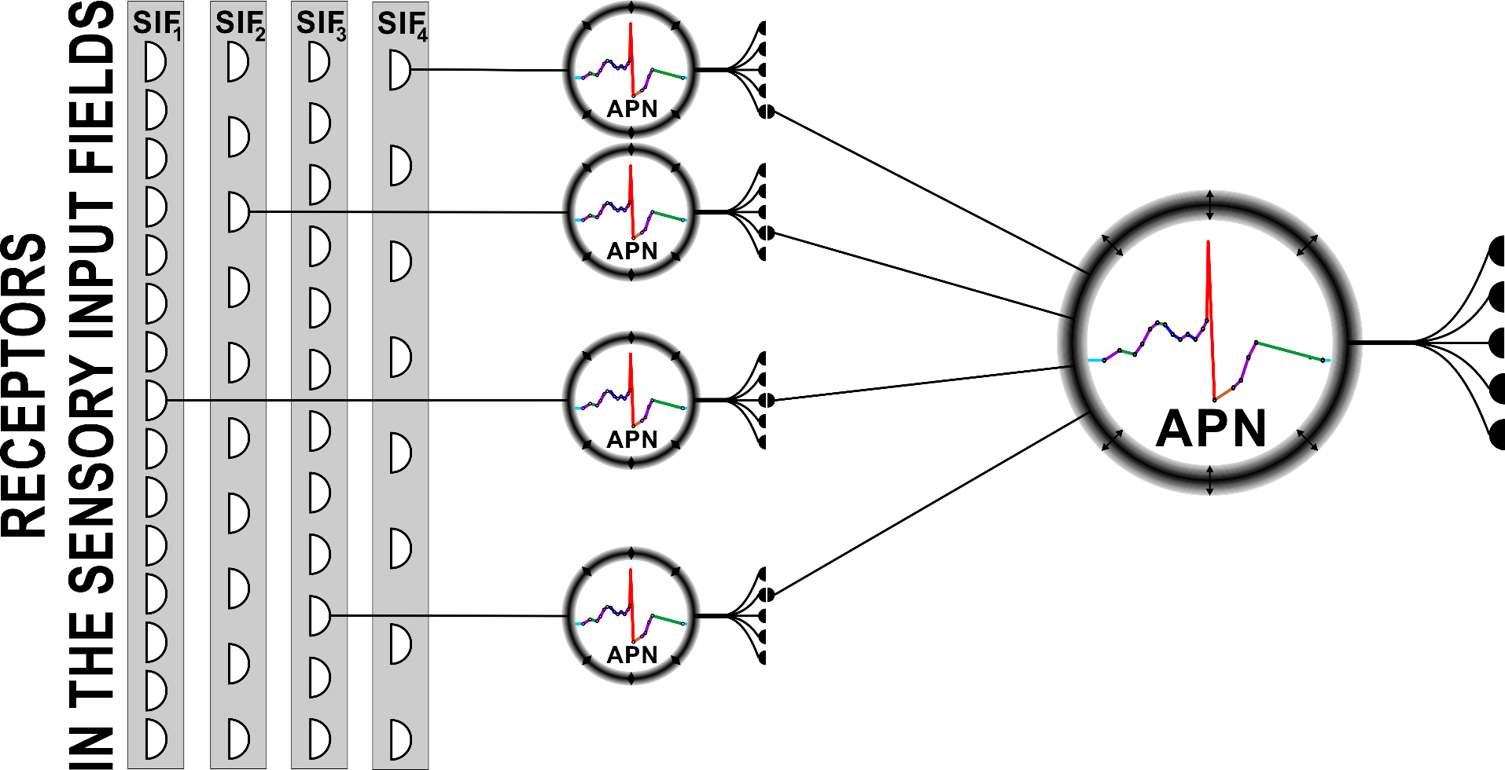
Receptor Stimulation
Receptors stimulate Sensory Neurons which stimulate Object Neurons.
Sensory Neurons react to the stimulations of the connected Receptors and code the stimulation strength in a form of pulse frequencies.
Variety of APN neurons in the network.

Slide 21
Receptor Stimulation
Receptors stimulate Sensory Neurons which stimulate Object Neurons.
The connected Object Neurons sum stimuli coming from Sensory Neurons and pulse when their pulsing thresholds are achieved.
Variety of APN neurons in the network.

Slide 22
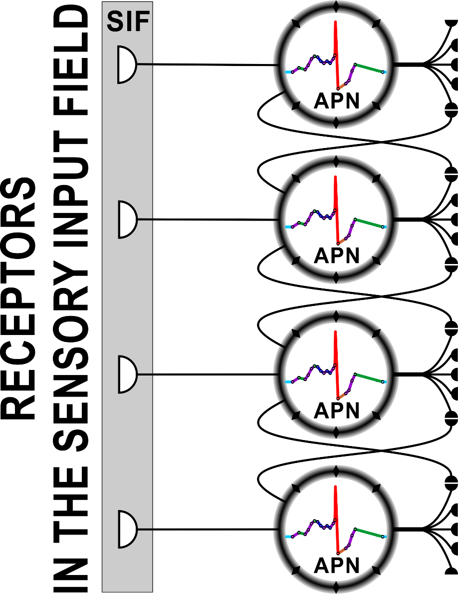
Receptor Stimulation Strength
Receptors stimulate Sensory Neurons with a strength coming from the similarity of the input stimulus $v^{a_{k}}$ to the value $v_{i}^{a_{k}}$ represented by the Receptor:
$$x_{v_{i}}^{a_{k}}=\left\{\begin{matrix}1−\frac{\left|v_{i}^{a_{k}}−v^{a_{k}}\right|}{r^{a_{k}}} if r^{a_{k}}>0 \\ \frac{\left|v_{i}^{a_{k}}\right|}{\left|v_{i}^{a_{k}}\right|+\left|v_{i}^{a_{k}}−v^{a_{k}}\right|} if r^{a_{k}}=0\end{matrix}\right.$$
Where $r^{a_{k}}=v_{max}^{a_{k}}−v_{min}^{a_{k}}$ is a range of values represented by the SIF, i.e.:
$v_{min}^{a_{k}}=min\left\{v_{i}^{a_{k}}\right\}$ and $v_{max}^{a_{k}}=max\left\{v_{i}^{a_{k}}\right\}$
$$v_{i−1}^{a_{k}}$$
$$x_{v_{i−1}}^{a_{k}}$$
$$v_{i}^{a_{k}}$$
$$x_{v_{i}}^{a_{k}}$$
$$v_{i+1}^{a_{k}}$$
$$x_{v_{i+1}}^{a_{k}}$$
$$x_{v_{i+2}}^{a_{k}}$$
$$v_{i+2}^{a_{k}}$$
Charging the APNs takes different time.

Slide 23
Sensory Neuron Activation Time
Sensory Neurons charge over time and according to the strength of the continuous stimulus of the Receptor it starts pulsing (activates) after the following period of time $t_{v_{i}}^{a_{k}}$ when it is solely stimulated by this Receptor:
$$t_{v_{i}}^{a_{k}}=\left\{\begin{matrix}\frac{r^{a_{k}}}{\left(r^{a_{k}}−\left|v_{i}^{a_{k}}−v^{a_{k}}\right|\right)} if r^{a_{k}}>\left|v_{i}^{a_{k}}−v^{a_{k}}\right| \\ ∞ if r^{a_{k}}=\left|v_{i}^{a_{k}}−v^{a_{k}}\right| \\ 1+\left|\frac{v_{i}^{a_{k}}−v^{a_{k}}}{v_{i}^{a_{k}}}\right| if r^{a_{k}}=0 \end{matrix}\right.$$
$$v_{i}^{a_{k}}$$
$$x_{v_{i}}^{a_{k}}$$
$$w=1−\frac{\left|v_{i}^{a_{k}}−v_{i+1}^{a_{k}}\right|}{r^{a_{k}}}$$
Sensory Neurons are connected to each other when they represent similar (neighbor) values represented by the Receptors because they pulse one after another as a result of the presentation of input data.
Implementation of the time approach in APNs.

Slide 24
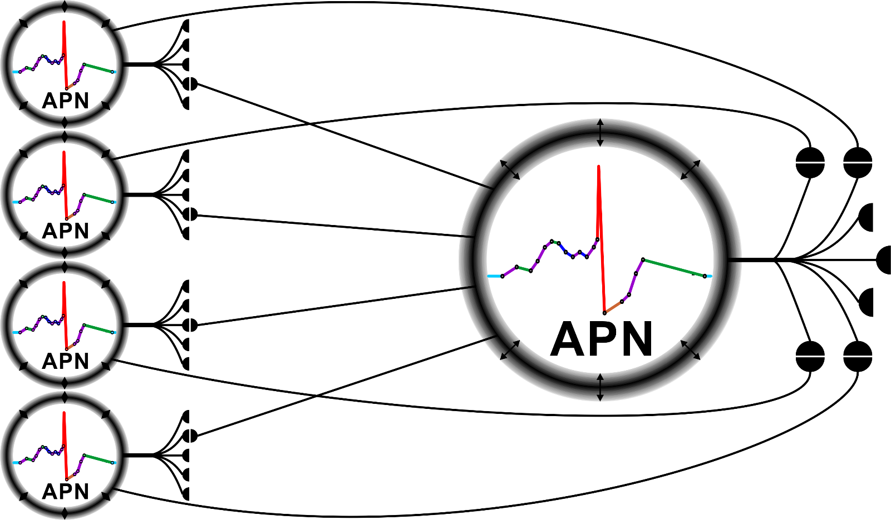
Stimulation of Object Neurons
$$w_{O_{j}^{T_{n}},S_{v_{i}}^{a_{k}}}$$
$$S_{v_{i}}^{a_{k}}$$
$$w_{S_{v_{i}}^{a_{k}},O_{j}^{T_{n}}}$$
$$O_{j}^{T_{n}}$$
The number of outgoing connection is taken into account when calculating the weights of the connections from the Sensory Neurons to the Object Neurons:
$w_{S_{v_{i}}^{a_{k}},O_{j}^{T_{n}}}=\frac{1}{N_{v_{i}}^{a_{k}}}$ and for the defining connections: $w_{O_{j}^{T_{n}},S_{v_{i}}^{a_{k}}}=1$
The connection rarity determines the certainty.

Slide 25
Thresholds of Object Neurons
$$w_{O_{j}^{T_{n}},S_{v_{i}}^{a_{k}}}$$
$$S_{v_{i}}^{a_{k}}$$
$$w_{S_{v_{i}}^{a_{k}},O_{j}^{T_{n}}}$$
$$O_{j}^{T_{n}}$$
The threshold of object neurons is usually equal one but in some cases it should be smaller to satisfy the necessity to active the Object Neuron by the defining combination of input stimuli:
$θ_{O_{j}}=\left\{\begin{matrix}1 if W_{O_{j}}≥1 \\ W_{O_{j}} if W_{O_{j}}<1\end{matrix}\right.$ where $W_{O_{j}}=\sum_{S_{v_{i}}^{a_{k}}}{w_{S_{v_{i}}^{a_{k}},O_{j}}}$
The connection rarity determines the certainty.

Slide 26
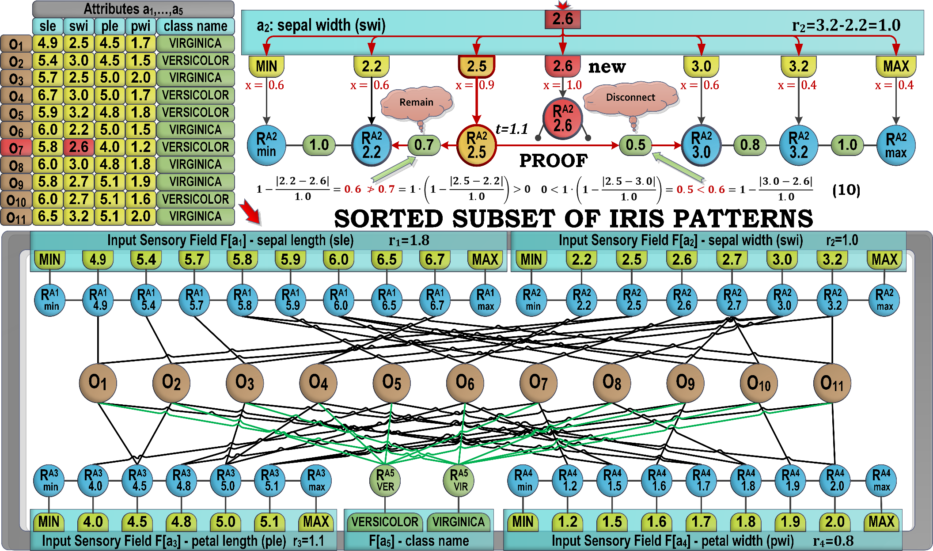
CONNECTION PLASTICITY
ASSORT-2 algorithm defines the conditions which must be met to create or update the connections between sensory neurons.

Slide 27
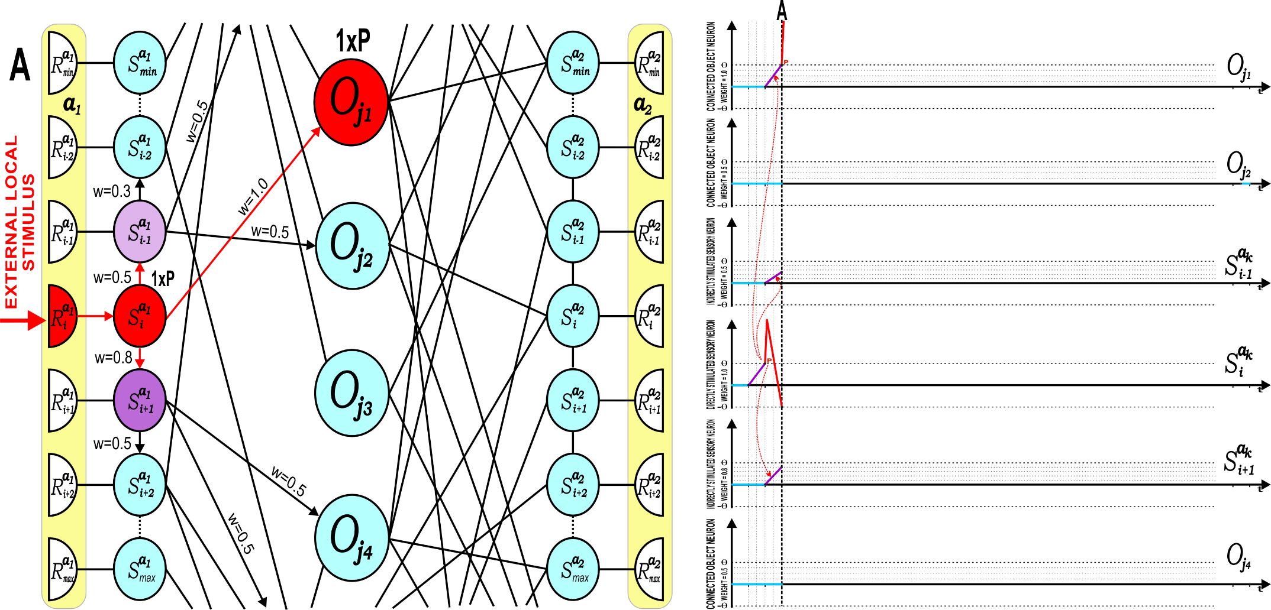
EVENT DRIVEN SIMULATION
Neural state changes according to the continuous input stimulus of the receptor $R_{i}^{a_{k}}$ and the forwarded pulses after activation of neurons.
Synaptic dependencies between receptors, sensory and object neurons.
Notes:
Neural state changes according to the continuous input stimulus of the receptor $R_{i}^{a_{k}}$ and the forwarded pulses after activation of neurons, where A, B, and C phases illustrate associated state changes.
Synaptic dependencies between receptors, sensory and object neurons. The lower part of the figure shows time domain state and activation levels for object neurons $O_{j1}$, $O_{j2}$, and $O_{j4}$ and sensory neurons $S_{i−1}^{a_{k}}$ , $S_{i}^{a_{k}},$and $S_{i+1}^{a_{k}}$. Only the sensory neuron $S_{i}^{a_{k}}$ is directly stimulated by the receptor $R_{i}^{a_{k}}$ and fires most often. The other neurons responses are based on their stimulation strength through associative weighted connections. Object neuron $O_{j1}$ fires more frequently than object neurons $O_{j2}$ and $O_{j4}$ because it is directly and more strongly connected to the most active neuron $S_{i}^{a_{k}}$, however the object neuron $O_{j2}$ fires earlier than the object neuron $O_{j4}$ since it has stronger synaptic connection from the sensory neuron $S_{i}^{a_{k}}$ to $S_{i−1}^{a_{k}}$ than to $S_{i+1}^{a_{k}}$.

Slide 28
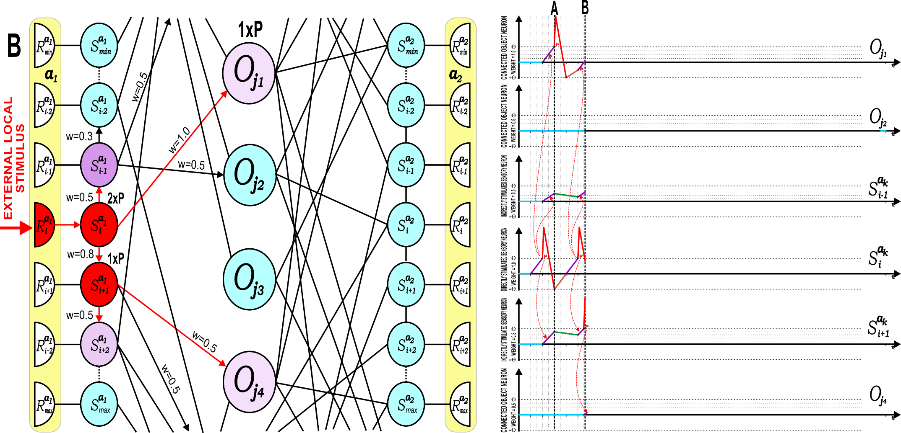
EVENT DRIVEN SIMULATION
Neural state changes according to the continuous input stimulus of the receptor $R_{i}^{a_{k}}$ and the forwarded pulses after activation of neurons.
Synaptic dependencies between receptors, sensory and object neurons.
Notes:
Neural state changes according to the continuous input stimulus of the receptor $R_{i}^{a_{k}}$ and the forwarded pulses after activation of neurons, where A, B, and C phases illustrate associated state changes.
Synaptic dependencies between receptors, sensory and object neurons. The lower part of the figure shows time domain state and activation levels for object neurons $O_{j1}$, $O_{j2}$, and $O_{j4}$ and sensory neurons $S_{i−1}^{a_{k}}$ , $S_{i}^{a_{k}},$and $S_{i+1}^{a_{k}}$. Only the sensory neuron $S_{i}^{a_{k}}$ is directly stimulated by the receptor $R_{i}^{a_{k}}$ and fires most often. The other neurons responses are based on their stimulation strength through associative weighted connections. Object neuron $O_{j1}$ fires more frequently than object neurons $O_{j2}$ and $O_{j4}$ because it is directly and more strongly connected to the most active neuron $S_{i}^{a_{k}}$, however the object neuron $O_{j2}$ fires earlier than the object neuron $O_{j4}$ since it has stronger synaptic connection from the sensory neuron $S_{i}^{a_{k}}$ to $S_{i−1}^{a_{k}}$ than to $S_{i+1}^{a_{k}}$.

Slide 29
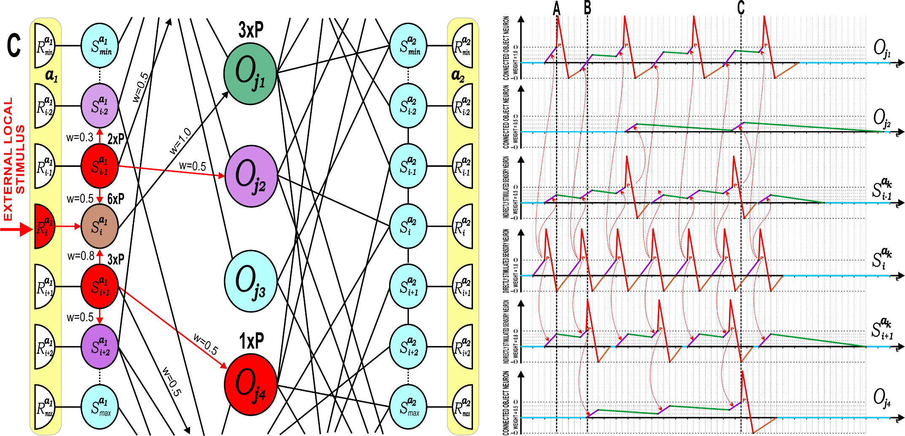
EVENT DRIVEN SIMULATION
Neural state changes according to the continuous input stimulus of the receptor $R_{i}^{a_{k}}$ and the forwarded pulses after activation of neurons.
Synaptic dependencies between receptors, sensory and object neurons.
Notes:
Neural state changes according to the continuous input stimulus of the receptor $R_{i}^{a_{k}}$ and the forwarded pulses after activation of neurons, where A, B, and C phases illustrate associated state changes.
Synaptic dependencies between receptors, sensory and object neurons. The lower part of the figure shows time domain state and activation levels for object neurons $O_{j1}$, $O_{j2}$, and $O_{j4}$ and sensory neurons $S_{i−1}^{a_{k}}$ , $S_{i}^{a_{k}},$and $S_{i+1}^{a_{k}}$. Only the sensory neuron $S_{i}^{a_{k}}$ is directly stimulated by the receptor $R_{i}^{a_{k}}$ and fires most often. The other neurons responses are based on their stimulation strength through associative weighted connections. Object neuron $O_{j1}$ fires more frequently than object neurons $O_{j2}$ and $O_{j4}$ because it is directly and more strongly connected to the most active neuron $S_{i}^{a_{k}}$, however the object neuron $O_{j2}$ fires earlier than the object neuron $O_{j4}$ since it has stronger synaptic connection from the sensory neuron $S_{i}^{a_{k}}$ to $S_{i−1}^{a_{k}}$ than to $S_{i+1}^{a_{k}}$.

Slide 30
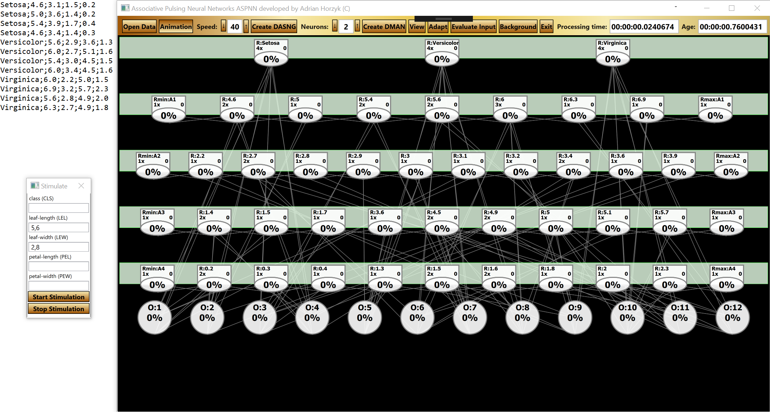
EXPERIMENTS
We will use a small subset of Iris data to demonstrate APNs in action:
Selected receptors will be stimulated and they start charging APNs.
APN Neural Network

Slide 31
ANIMATION
We start to stimulate receptors sensitive for values 5.6 and 2.8:
The most associated neurons charge the fastest and most often!
APN Neural Network
Notes:
To be filled with:
„The authors should perform experiments to prove the proposed method.” [Reviewer]
„Additionally, it would be also interesting to include an example at least of the tentative applications of the proposed approach claimed by the authors. Thus, it would be easier to assess the validity and utility of the model regardless its qualitative properties.” [Reviewer]
„Because the presented model is simplified, then it would be good to show using an example (empirically tested), that it is not performing worse than, for instance, the spiking model… . Again, some real-world data / performed experiments are expected. The presented model is quite sophisticated and while fast, quite complex in terms of definition. It is quite impossible to tell, based only on the theoretical description, that it is suitable for all the mentioned tasks at least equally well as APNs.” [Reviewer, Yes to BPA]

Slide 32
APN

Slide 33
Conclusions
Associative Pulsing Neurons (APNs) represent these combinations of input stimuli which make them pulsing.
The Associative Pulsing Neurons which pulse first and most frequently represent the most associated values, objects, or pieces of information with an input context, and represent the answer of the network that is distributed in time according to the time of the pulses.

Slide 34
Conclusions
Associations represented by APN connections can represent various relations:
Similarity of values or objects
Proximity of objects in space
Succession of objects in time
Context for further stimulations

Slide 35
Conclusions
APN internal processes are efficiently managed, updated, and ordered by:
IPQ – Internal Process Queue which transforms all stimulations to the form of subsequent and not overlapping in time processes.
GEQ – Global Event Queue which sorts and watches out the moments in time when each neuron should be updated and in what sequence.

Slide 36
Conclusions
APN neurons create a dedicated network structure for given training data automatically and very fast in comparison to other ontogenic algorithms.
APN also learn and work a few times faster than many contemporary spiking models of neurons, e.g. Izhikevich spiking neurons, according to fast linear approximation and combinations of internal neural processes.

Slide 37
Conclusions
APN neurons are updated in discrete moments of time:
when a new external stimulus comes,
when the internal process is finished.
These features of the APN model determine the high speed of simulation together with the smart implementation of short IPQs and the GEQ.

Slide 38
Questions or Remarks?
A. Horzyk, J. A. Starzyk, J. Graham, Integration of Semantic and Episodic Memories, IEEE Transactions on Neural Networks and Learning Systems, 2017, DOI: 10.1109/TNNLS.2017.2728203.
A. Horzyk, Deep Associative Semantic Neural Graphs for Knowledge Representation and Fast Data Exploration, Proc. of KEOD 2017, SCITEPRESS Digital Library, 2017.
A. Horzyk, Neurons Can Sort Data Efficiently, Proc. of ICAISC 2017, Springer-Verlag, LNAI, 2017, pp. 64-74, ICAISC BEST PAPER AWARD 2017 sponsored by Springer.
A. Horzyk, J. A. Starzyk and Basawaraj, Emergent creativity in declarative memories, IEEE Xplore, In: 2016 IEEE Symposium Series on Computational Intelligence, Greece, Athens: Institute of Electrical and Electronics Engineers, Curran Associates, Inc. 57 Morehouse Lane Red Hook, NY 12571 USA, 2016, ISBN 978-1-5090-4239-5, pp. 1-8, DOI: 10.1109/SSCI.2016.7850029.
A. Horzyk, Human-Like Knowledge Engineering, Generalization and Creativity in Artificial Neural Associative Systems, Springer-Verlag, AISC 11156, ISSN 2194-5357, ISBN 978-3-319-19089-1, ISBN 978-3-319-19090-7 (eBook), DOI 10.1007/978-3-319-19090-7, Springer, Switzerland, 2016, pp. 39-51.
A. Horzyk, Innovative Types and Abilities of Neural Networks Based on Associative Mechanisms and a New Associative Model of Neurons - Invited talk at ICAISC 2015, Springer-Verlag, LNAI 9119, 2015, pp. 26-38, DOI 10.1007/978-3-319-19324-3_3.
Horzyk, A., How Does Generalization and Creativity Come into Being in Neural Associative Systems and How Does It Form Human-Like Knowledge?, Neurocomputing, 2014.
…..
Adrian Horzyk
horzyk@agh.edu.pl
Google: Horzyk
Janusz A. Starzyk
starzykj@ohio.edu
Google: Janusz Starzyk
University of Science and Technology in Krakow, Poland
Athens, OH, U.S.A.

