Slide 1
Lumped Mini-Column
Associative Knowledge Graphs
Basawaraj¹, J. A. Starzyk^{1,2}, and A. Horzyk³
¹School of Electrical Engineering and Computer Science
Ohio University, Athens, OH, USA
²University of Information Technology and Management
Rzeszow, Poland
³Department of Automatics and Biomedical Engineering,
AGH University of Science and Technology, Krakow, Poland

Slide 2

Content
Introduction
Associative Neurons
Semantic Memory
Lumped Mini-column Associative Learning Graph LUMAKG
LUMAKG Organization and Principles
LUMAKG Algorithm
Recall Resolution
Comparative Tests
Computational Complexity
Conclusion
Notes:
http://clipartsign.com/upload/2016/02/03/writing-clipart-4-2.png

Slide 3

Introduction
Intelligence is the ability to learn, and to profit, from experience, and adapt to relatively new situations.
Intelligence enables:
  Acquire and store knowledge
  Contextually associate knowledge
  Make generalizations and draw conclusions
  Recall memories and apply knowledge to solve new problems
Intelligence requires:
  Sensory and motor capacity
  Memory, semantic and episodic
  Mechanism to store and associate information to form knowledge
  Motivation to act
Notes:
http://www.thinknicolecarvill.com/mindful-moments-6/

Slide 4
Problems Addressed in this Work
Problem 1: Associative mechanisms needed to “form” knowledge from “observed facts” and experiences
  Solution: Use associative neural graphs!
Why associative neural graphs?
  Can be used to store and recall sequential memories
  Form associations between “facts”
Problem 2: Observations are context dependent, mechanism needed to “store” contexts
  Solution: Use minicolum structure for representation!
Why mincolumn?
  Increase contextual knowledge but not confusion
Notes:
Why minicolumns: Without minicolumns, i.e., 1 neuron symbol, as the number of connections (or contextual knowledge) increases (due to use of a word in multiple sentences) the number of connections increases. This increased in connections can lead to large number of excitations and potentially cause confusion, but with minicolumns the connections are distributed across the neurons in the minicolum and consequently confusion decreased.

Slide 5
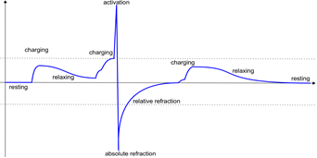
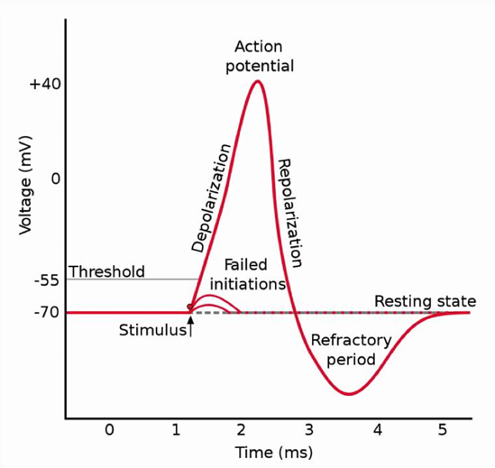
Associative Neuron
How to model a neuron?
  Use biological neurons as reference.
  Why biological neurons? Efficient and robust.
Connections between biological neurons automatically strengthened if activation of one leads to activation of another within short intervals and weakened if another neuron is triggered after longer delay

Slide 6
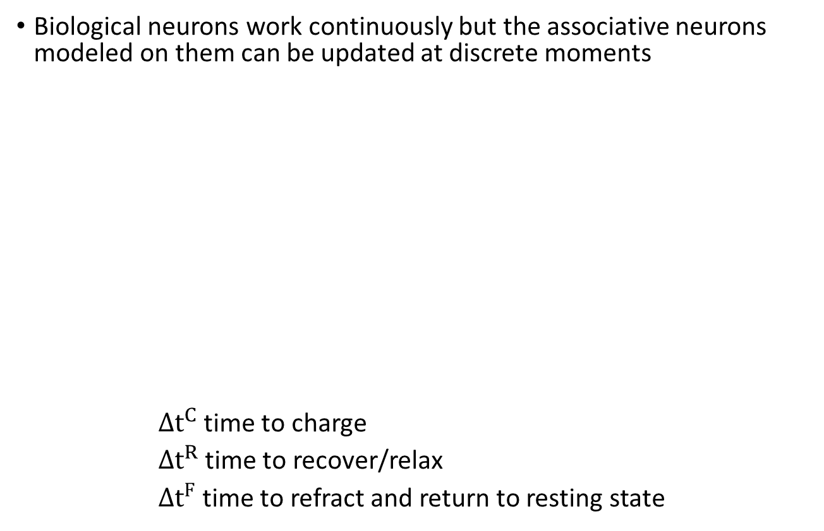
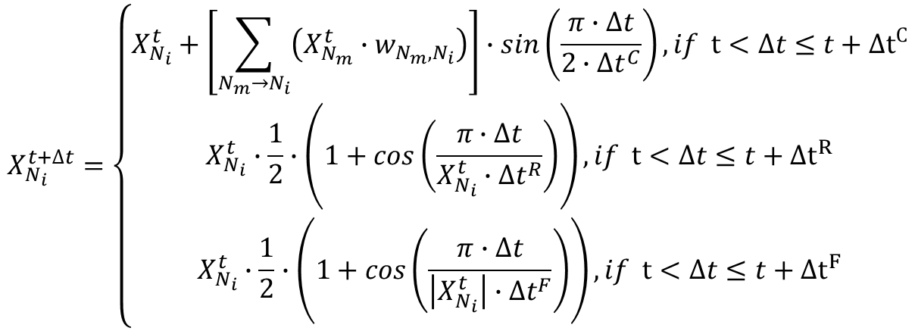
Associative neuron excitation levels
http://biomedicalengineering.yolasite.com/neurons.php

Slide 7
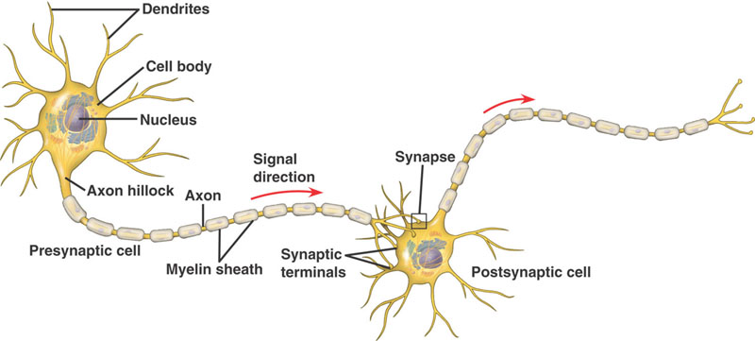
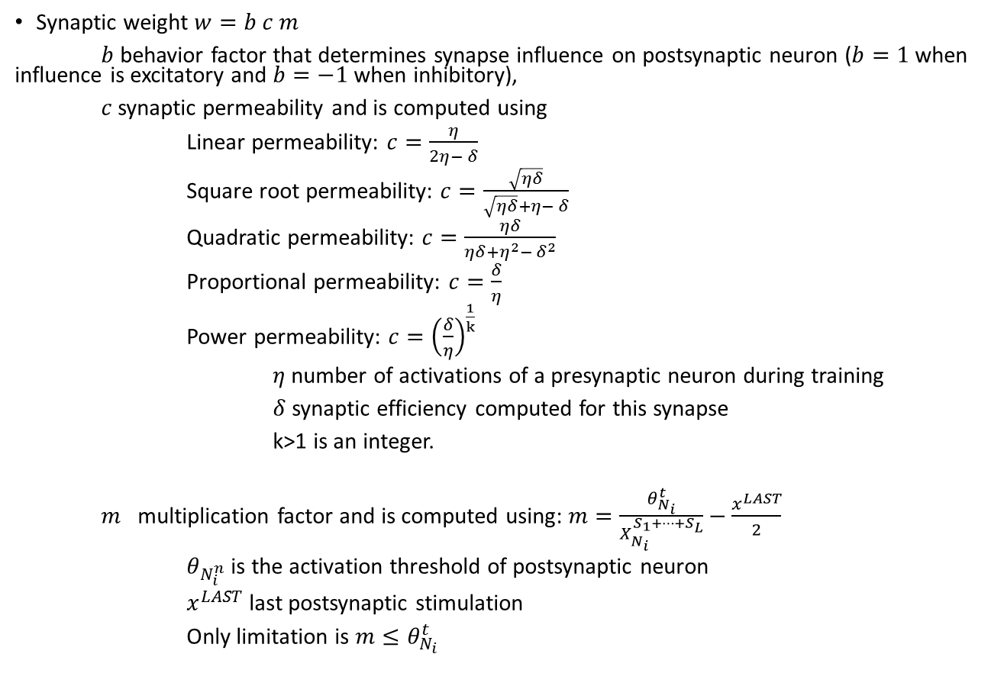
Synaptic Weight
Synaptic weight $w=b c m$
$b$ behavior factor that determines synapse influence on postsynaptic neuron ($b=1$ when influence is excitatory and $b=−1$ when inhibitory),
$c$ synaptic permeability and is computed using
Linear permeability: $c=\frac{η}{2η− δ}$
Square root permeability: $c=\frac{\sqrt{ηδ}}{\sqrt{ηδ}+η− δ}$
Quadratic permeability: $c=\frac{ηδ}{ηδ+η^{2}− δ^{2}}$
Proportional permeability: $c=\frac{δ}{η}$
Power permeability: $c={\left(\frac{δ}{η}\right)}^{\frac{1}{k}}$
$η$ number of activations of a presynaptic neuron during training
$δ$synaptic efficiency computed for this synapse
k>1 is an integer.
$m$ multiplication factor and is computed using: $m=\frac{θ_{N_{i}}^{t}}{X_{N_{i}}^{S_{1}+…{+S}_{L}}}−\frac{x^{LAST}}{2}$
$θ_{N_{i}^{n}}$ is the activation threshold of postsynaptic neuron
$x^{LAST}$ last postsynaptic stimulation
Only limitation is $m≤θ_{N_{i}}^{t}$
http://biomedicalengineering.yolasite.com/neurons.php

Slide 8
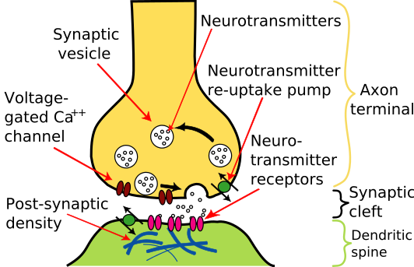
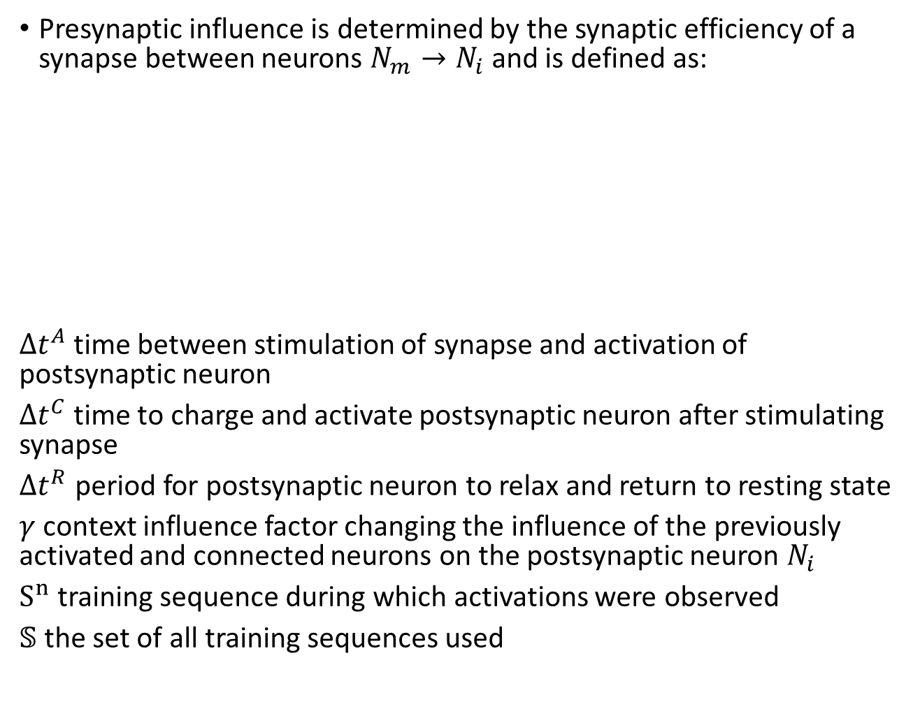
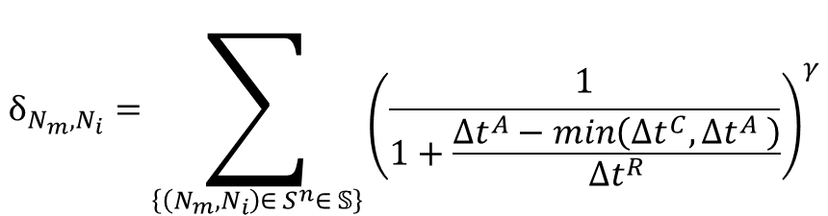
Synaptic Efficiency
Presynaptic influence is determined by the synaptic efficiency of a synapse between neurons $N_{m}→N_{i}$ and is defined as:
$∆t^{A}$ time between stimulation of synapse and activation of postsynaptic neuron
$∆t^{C}$ time to charge and activate postsynaptic neuron after stimulating synapse
$∆t^{R}$ period for postsynaptic neuron to relax and return to resting state
$γ$ context influence factor changing the influence of the previously activated and connected neurons on the postsynaptic neuron $N_{i}$
$S^{n}$ training sequence during which activations were observed
$𝕊$ the set of all training sequences used
$$δ_{N_{m},N_{i}}=\sum_{\left\{\left(N_{m},N_{i}\right)∈ S^{n}∈ 𝕊\right\}}{{\left(\frac{1}{1+\frac{∆t^{A}−\min\left(∆t^{C}, ∆t^{A} \right)}{∆t^{R}}}\right)}^{γ}}$$
http://www.wikiwand.com/nl/Synaps

Slide 9
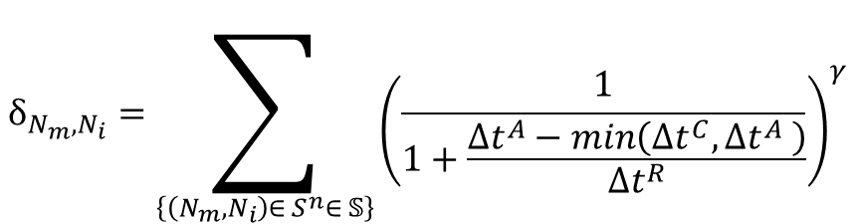
Synaptic Efficiency
Presynaptic influence is determined by the synaptic efficiency of a synapse between neurons $N_{m}→N_{i}$ and is defined as:
$∆t^{A}$ time between stimulation of synapse and activation of postsynaptic neuron
$∆t^{C}$ time to charge and activate postsynaptic neuron after stimulating synapse
$∆t^{R}$ period for postsynaptic neuron to relax and return to resting state
$γ$ context influence factor changing the influence of the previously activated and connected neurons on the postsynaptic neuron $N_{i}$
$S^{n}$ training sequence during which activations were observed
$𝕊$ the set of all training sequences used
$$δ_{N_{m},N_{i}}=\sum_{\left\{\left(N_{m},N_{i}\right)∈ S^{n}∈ 𝕊\right\}}{{\left(\frac{1}{1+\frac{∆t^{A}−\min\left(∆t^{C}, ∆t^{A} \right)}{∆t^{R}}}\right)}^{γ}}$$
http://www.wikiwand.com/nl/Synaps

Slide 10
Semantic Memory
Structured record of facts, meanings, concepts and knowledge about the world
General factual knowledge, shared with others and independent of personal experience and of the spatial/temporal context in which it was acquired.
May once have had a personal context, but now stand alone as general knowledge.
  E.g. types of food, capital cities, social customs, functions of objects, vocabulary, etc.
Abstract and relational
  Representation is obtained through symbol grounding, associating sensory data with action and reward obtained by the system in its interaction with the environment.
Uses an active neuro-associative knowledge graph (ANAKG) – that can represent and associate training sequences of objects or classes of objects.
Synaptic connections are weighted, each association has its own importance.
Can provide common sense solutions to new situations that were not experienced before.

Slide 11
Lumped Mini-column Associated Knowledge Graph (LUMAKG)
Active Neural Associative Knowledge Graph (ANAKG) used to build semantic memory
Minicolumn structure successfully used to build memories
  Cortical Learning Algorithms for Hierarchical Temporal Learning (HTM), general framework for perceptual learning, by Numenta.
  HTM – sensitive to temporal noise
LUMAKG – Generalization of ANAKG to mini-column form.
  Minicolumn structure better for storing spatio-temporal relations
  ANAKG – lower sensitivity to temporal noise
Notes:
HTM – more sensitive to temporal noise compared to long-short-term memory, where as ANAKG does not have this drawback.
Fig: CLA region is a column of cells. Each column receive inputs from a region of the input, called the receptive field, and competes with neighboring columns to become active.
Fig. from: P. Agrawal and S. Franklin, "Multi-layer Cortical Learning Algorithms," in 2014 IEEE Symposium Series on Computational Intelligence, Orlando, FL, December 9-12 2014.

Slide 12
LUMAKG Organization and Principles
Symbolic representation used
  Each symbol represents a unique word
Min-column with 5 neurons used for each symbol
  External activations activate all neurons in the mini-column
  Outputs, and synaptic connections are different and distributed across the neurons
LUMAKG network structure obtained dynamically
  New mini-columns added when new symbols are observed
  New synaptic connections added when new relations observed, else existing connections suitably modified

Slide 13
Organization Principles
Duplicate each symbol five times to form individual symbol mini-columns.
If a node in a mini-column is activated above the threshold from associative connections, it is called to be in a predictive mode.
An input activates either all nodes in a given mini-column that are in the predictive mode or the whole mini-column if no node is in a predictive mode.
Activated nodes that were in a predictive mode are in predicted activation (PA).
An activated mini-column without any node in a predictive mode has all nodes in unpredicted activation (UA).
Synaptic connections weights are changed between activated nodes in predecessor and successor mini-columns.

Slide 14
LUMAKG Algorithm
Read the consecutive elements of the input sequence to activate corresponding mini-columns
  Add a new mini-column if the symbol from the input sequence is not represented, all nodes of this new mini-column are in unpredicted activation (UA).
Establish predecessor-successor nodes in all activated mini-columns in the input sequence
  For each consecutive activated mini-column, activate nodes in the mini-column that corresponds to the input symbol (all nodes in the predictive mode or whole mini-column if no node in predictive mode).
  Find the first mini-column with a PA node and name this first predicted activation (FPA) mini-column
    If no such column exists choose a node in the last mini-column with a minimum number of outgoing connections and treat it as a PA node.
Notes:
Typically, the first activated mini-column has no PA nodes, unless it is considered in a broader context of associative learning. Thus typically, all nodes in the first activated mini-column are in unpredicted activation.
The subsequent steps address the modification of synaptic weights. Since the LUMAKG algorithm has a convoluted process for modifications of synaptic connections, a simple example is used to illustrate the subsequent steps. Note that while in this illustration we assume, for simplicity, that a PA node makes a single prediction and that at most a single PA node is activated in any mini-column, the algorithm is not limited to such cases. These assumptions are made only to simplify the example illustration of the LUMAKG algorithm.

Slide 15
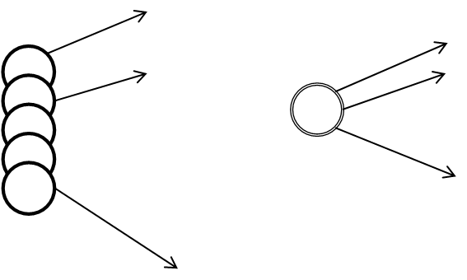
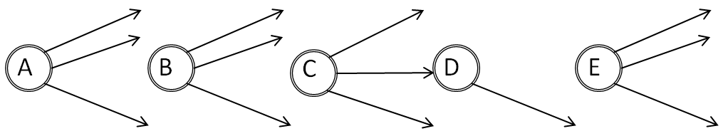
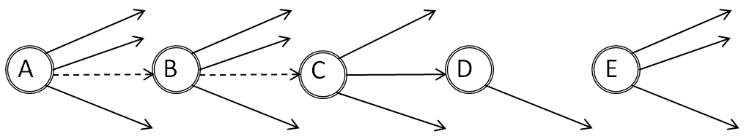
LUMAKG Algorithm
Mini-column and simplified symbol
Activated mini-columns with links
Starting from the predecessor mini-column to FPA:
  Choose a node in this mini-column that has a link to the PA node in FPA and treat it as a PA node. If no such node exists, choose a node with the minimum number of outgoing connections, create a connection to establish a link between the nodes, and treat it as a PA node.
Repeat this step for the new PA node until no predecessor mini-column is found.
Notes:
For simplicity of graphical illustration, a mini-column is represented by a single node, the actual and simplified symbols are shown in the figure on the top-left.
Assume that the sequence A, B, C, D, E was inputted to the LUMAKG memory and activated the corresponding mini-columns as shown in the figure on the top-right
Here mini-column ‘D’ would be the only mini-column with a PA node, hence we name ‘D’ the FPA mini-column.
Following the algorithm, we move to the predecessor mini-column ‘C’, name the node linked to PA node in D as the new PA node. The predecessor minicolumn to C is B, but there exists no link, hence following the algorithm we choose a node in mini-column B with the minimum number of outgoing connections and treat it as a PA node. Now moving back to the minicolumn A and applying the same algorithm, node in minicolumn A with the minimum number of outgoing connections is selected and treated as the new PA node. The connections at the end of this step are shown in the figure on the bottom. The newly created connections are shown by dotted lines.
As there are no more predecessor nodes we move to the next step.

Slide 16
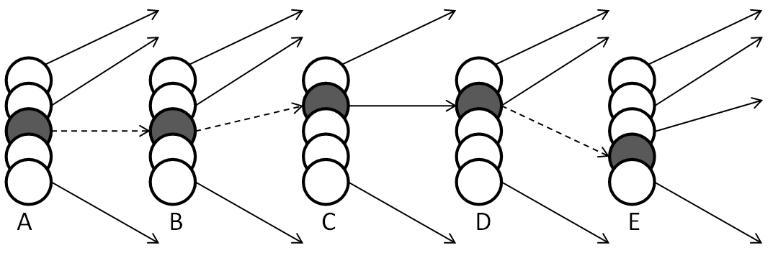
LUMAKG Algorithm
Starting from the successor mini-column to FPA repeat until no more successor mini-column is found:
  If the successor mini-column has a PA node, link the two PA nodes and move to the successor mini-column.
  If the successor is a unpredicted activation (UA) mini-column, choose a node in this mini-column with the minimum number of outgoing connections and treat it as a PA node. Link the two PA nodes and move to the successor mini-column.
Notes:
Since there is no PA node in mini-column E, we choose the node in mini-column E with the minimum number of outgoing connections and treat it as a PA node. This establishes the link between the two PA nodes in mini-columns D and E. Since there are no successor mini-columns to E the algorithm moves to the next step.
The final mini-column structure with connections between nodes in mini-column D and E is shown here. Note that gray color is used to represent PA neurons that will have their synaptic connection weights changed according to the previously discussed ANAKG algorithm.

Slide 17
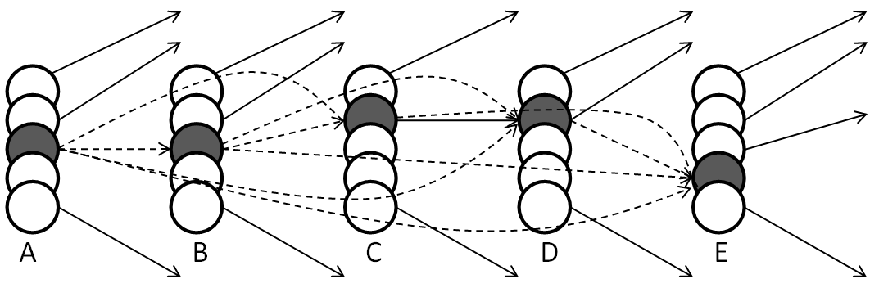
LUMAKG Algorithm
Update synaptic weights in the synaptic connections between all predecessor successor nodes:
  The algorithm updates all the synaptic weights between all PA nodes in predecessor and successor mini-columns are updated according to the ANAKG algorithm.
Notes:
The updated links after the application of the ANAKG algorithm to modify weights between the selected PA nodes is shown here.

Slide 18
Comparative Testing: LUMAKG vs ANAKG
Training sequences:
  The king had a beautiful garden, and in the garden stood a tree.
  The tree bore golden apples, apples that were always counted.
  About the time when the apples grew ripe, it was found that every night one apple was gone.
  The king was angry at an apple going missing every night.
  The king ordered his gardener to keep watch all night under the tree.
  The first day the gardener asked his eldest son to keep watch.
  About midnight he fell asleep, and in the morning another of the apples was missing.
  The second day the gardener asked his second son to keep watch.
  At midnight he too fell asleep, and in the morning another of the apples was missing.
Notes:
Tests were performed to compare the efficiency of learning, memory capacity, and learning resolution of LUMAKG and ANAKG memories. All tests were performed on the same equipment and using the same software environment. In fact, LUMAKG was based on a modified ANAKG tool.
The first test was to measure the resolution of recalled sequences. For these tests a set of sentences from “the golden bird” tale from “Grimm’s fairy tales”, and shown here, were chosen.

Slide 19
Recall Resolution- Test I Small Training Set
Sequences related to training sequences used to test recall abilities.
Results show that LUMAKG provides more meaningful answers than ANAKG
Input sequence | ANAKG memory output | LUMAKG memory output | Desired output
What did the king had? | The king had a beautiful garden | The king had a beautiful garden | The king had a beautiful garden
What stood in the garden? | Stood a in the tree the garden | Stood in the garden stood a tree | In the garden stood a tree
Why was the king angry? | Was the king angry at an apple missing | Was the king was angry at an apple missing | The king was angry at an apple going missing
What were always counted? | Were always counted | Were always counted | Apple that were always counted
What did the king order his gardener? | the king his gardener | The king was his gardener to keep watch | The king ordered his gardener to keep watch
What was missing in the morning? | Was missing in the morning another of the apple was | Was missing in the morning another of the apple was missing | In the morning another of the apple was missing
Notes:
The results show that LUMAKG provides more meaningful answers than ANAKG, highlighted using boldface. And there existed no case in which ANAKG provided more meaningful answers than LUMAKG. The inputs sentences used in this test were not specifically tailored to benefit one method over another. As we can see, in no case ANAKG provided answers more meaningful than LUMAKG.

Slide 20
Recall Resolution – Test II Larger Training Set
Test repeated
  78 training sentences
  Over 2500 words, with over 500 unique words
Input sequence | ANAKG memory output | LUMAKG memory output | Desired output
What did the king had? | What did the king had | What did the king had a beautiful garden | The king had a beautiful garden
What stood in the garden? | What stood in the garden | What stood in the garden stood a tree | In the garden stood a tree
Why was the king angry? | Why should was the king angry at | Why should was the king angry at an apple | The king was angry at an apple going missing
What were always counted? | What were always counted | What were always counted | Apple that were always counted
What did the king order his gardener? | What did the king his gardener | What did the king his gardener to keep watch | The king ordered his gardener to keep watch
What was missing in the morning? | What was missing in the morning | What was missing in the morning another of the apple | In the morning another of the apple was missing
Notes:
The previous test protocol was repeated, but with a larger training set consisting of the complete story of “the golden bird”. The resulting network had over 500 unique words from a total of over 2500 words. The results again show that LUMAKG provides more meaningful answers than ANAKG, again highlighted using boldface. Please note that the inputs sentences used in this test were not specifically tailored to benefit one method over another.

Slide 21
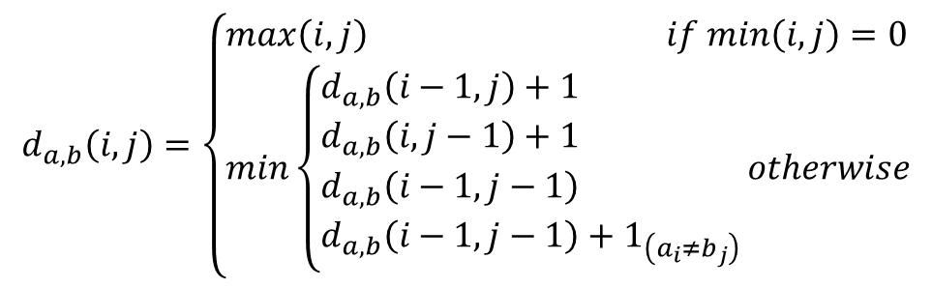
Levenshtein Distance Quality Measure
Levenshtein distance between two string a and b, of lengths u and v respectively, is given by
d_{a,b}(i,j) – distance between first i and j elements of string a and b
$$d_{a,b}\left(i,j\right)=\left\{\begin{aligned}&max\left(i,j\right) if min\left(i,j\right)=0 \\ &min\left\{\begin{aligned}&d_{a,b}\left(i−1,j\right)+1 \\ &d_{a,b}\left(i,j−1\right)+1 \\ &d_{a,b}\left(i−1,j−1\right) \\ &d_{a,b}\left(i−1,j−1\right)+1_{\left(a_{i}≠b_{j}\right)}\end{aligned}\right.otherwise\end{aligned}\right.$$
Notes:
The previous results showed LUMAKG to have better recall abilities, based on the “meaningfulness” of the responses. But meaningfulness is a subjective measure, and hence Levenshtein Distance Quality Measure and a distance measure called reciprocal word position were used to further compare the recall abilities of LUMAKG and ANAKG.
Note that the levenshtein distance measures the number of characters that must be deleted, inserted, or substituted in order to transform a source string into a target string. But here we are interested in sequence of words rather than characters. Hence, here we measure the number of words that must be deleted, inserted, or substituted, rather than the characters.

Slide 22
Levenshtein Distance Quality Measure
Input sequence | ANAKG |  | LUMAKG
 | Test I | Test II | Test I | Test II
What did the king had? | 0 | 5 | 0 | 2
What stood in the garden? | 6 | 5 | 1 | 2
Why was the king angry? | 3 | 8 | 2 | 6
What were always counted? | 2 | 2 | 2 | 2
What did the king order his gardener? | 4 | 6 | 1 | 3
What was missing in the morning? | 3 | 8 | 2 | 5
Notes:
Levenshtein distance measure was applied to both the previous tests, Test I with 9 training sequences and Test 2 with 78 training sequences.
The results, shown here, show that the results from LUMAKG were either better of the same as those obtained from ANAKG. And while both types of associative memories showed that they could provide a reasonable output given a limited training data set, LUMAKG has a promise to significantly increase the resolution of the associative knowledge graphs.

Slide 23
Recall Resolution- Test I Small Training Set
Desired output shares words/symbols with test sequence
  Consequence of forming grammatically valid sentences
  Multiple possible grammatically valid responses possible
  Consider only output symbols not in input sequence
Input sequence | ANAKG memory output | LUMAKG memory output | Desired output
What did the king had? | a beautiful garden | a beautiful garden | a beautiful garden
What stood in the garden? | a tree | a tree | a tree
Why was the king angry? | at an apple missing | at an apple missing | at an apple going missing
What were always counted? |  |  | Apple that
What did the king order his gardener? |  | was to keep watch | to keep watch
What was missing in the morning? | another of apple | another of apple | another of apple
Notes:
The desired outputs used in the above tests share words with the input test sequence. This is necessitated by the need to generate grammatically valid answers. But multiple grammatically valid responses are possible. Thus, limiting the usefulness of Levenshtein distance measure used earlier. Hence, we measured the quality of responses disregarding the words/symbols from the input sequence that are present in the desired output, and the actual outputs of the ANAKG and LUMAKG networks.
The output sequences disregarding words from the input sequence for Test I, with 9 training sequences, is shown here.

Slide 24
Recall Resolution – Test II Larger Training Set
Input sequence | ANAKG memory output | LUMAKG memory output | Desired output
What did the king had? |  | a beautiful garden | a beautiful garden
What stood in the garden? |  | stood a tree | a tree
Why was the king angry? | should at | should at an apple | at an apple going missing
What were always counted? |  |  | Apple that
What did the king order his gardener? |  | to keep watch | to keep watch
What was missing in the morning? |  | another of apple | another of apple
Notes:
The output sequences disregarding words from the input sequence for Test II, with 78 training sequences, is shown here.

Slide 25
Levenshtein Distance Quality Measure
Input sequence | ANAKG |  | LUMAKG
 | Test I | Test II | Test I | Test II
What did the king had? | 0 | 3 | 0 | 0
What stood in the garden? | 0 | 2 | 0 | 1
Why was the king angry? | 1 | 5 | 1 | 3
What were always counted? | 2 | 2 | 2 | 2
What did the king order his gardener? | 3 | 3 | 1 | 0
What was missing in the morning? | 0 | 3 | 0 | 0
Notes:
Levenshtein distance measure was applied to this modified set of desired and expected results.
The results show that performance of LUMAKG was the same or better than that of ANAKG. These results also show that while both ANAKG and LUMAKG can provide reasonable responses when trained with a small dataset the performance of LUMAKG is better when there are a large number of sequences in the training set.

Slide 26
Reciprocal Word Position
Reciprocal Word Position (RWP) - measures user’s effort in extracting the desired response from the output generated by the semantic memory.
RWP is calculated as follows:
Compare the positions of all the words in the desired output to those in the actual memory output
  if the positions are the same the word gets a weight of 1;
  if the positions are different by ‘n’ words the word gets a weight of 1/(n+1);
  if a word does not exist it gets a weight of 0;
  RWP equals to the sum of the weights of all the words in the desired sequence divided by the maximum of the number of words in the desired and actual outputs.
  RWP has values between 0 and 1
  The higher the value of RWP the better match to the desired output
Notes:
A difficulty in evaluating responses or answers of semantic memories, like those based on ANAKG and LUMAKG, is the difficulty in determining what is the correct response from associative spatio-temporal memory? Thus, Levenshtein distance while a good measure of text similarity is, in this case, limited. Hence, we designed a new quality measure called reciprocal word position (RWP).
The measure is normalized since the lowest value is 0 and the highest is 1 and a higher value of RWP indicate better match between the sequences.

Slide 27
Reciprocal Word Position
Input sequence | ANAKG |  | LUMAKG
 | Test I | Test II | Test I | Test II
What did the king had? | 1 | 0 | 1 | 1
What stood in the garden? | 1 | 0 | 1 | 1/3
Why was the king angry? | 7/10 | 1/10 | 7/10 | 3/10
What were always counted? | 0 | 0 | 0 | 0
What did the king order his gardener? | 0 | 0 | 3/8 | 1
What was missing in the morning? | 1 | 0 | 1 | 1
Notes:
The results applying RWP measure to the ANAKG and LUMAKG memory outputs show that the performance of LUMAKG based semantic memory is equal to or better in all cases than ANAKG based semantic memory and its relative recall quality over ANAKG increases as the memory size increases.

Slide 28
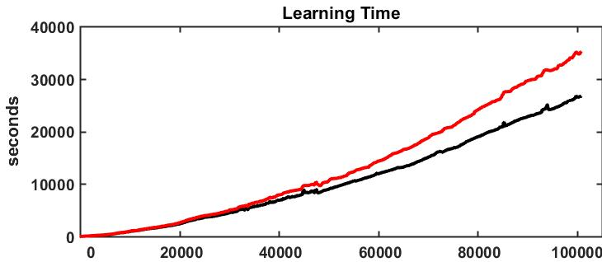
Computational Complexity
The third type of tests was performed to determine computational complexity of LUMAKG memory in comparison to ANAKG memory.
Measured time needed to create the associative memory as a function of the number of objects.
Notes:
Fig. shows the learning time for both ANAKG and LUMAKG as a function of all objects in the data set. We see that computational cost for LUMAKG is between 30-40% higher than for ANAKG.
The number of neurons in LUMAKG memory is k times larger than in ANAKG memory, where k is the number of neurons in each mini-column (in our tests k=5). However, the number of synapses does not grow as fast since the number of associative links between all neurons corresponds to the number of transitions between various words. They are just spread over the larger number of neurons. Although the training time is greater for LUMAKG than for ANAKG due to the need of finding predecessor and successor for each element of the training sequence, the quality of results points to better properties of LUMAKG graphs, which make them more suitable to develop short term associative memories.

Slide 29
Conclusion
We developed and tested a mini-column based ANAKG structure, called LUMAKG.
LUMAKG shows better ability to recall sequences stored in the memories than ANAKG to which it was compared.
Levenshtein distance and RWP measure show that LUMAKG memory has higher capacity and better resolution for short term memory recall.
Future work:
  Extend LUMAKG to a distributed representation of all symbols stored in the memory, to significantly increase memory storage capacity.
  Use larger training and test data sets to obtain a better assessment of the network properties.
  Study the effect of varying the number of neurons in minicolumns.

Slide 30
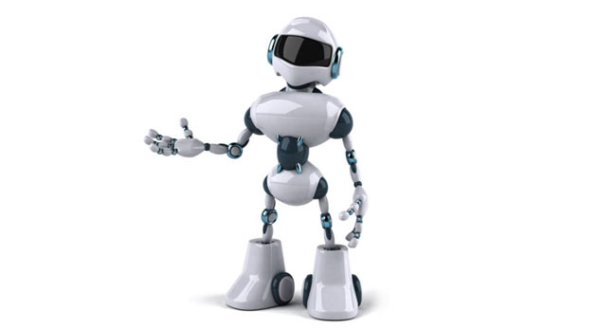
Questions?

