Slide 1
Visual Saccades for Object Recognition
Janusz Starzyk^{1, 2},
¹School of Electrical Engineering and Computer Science
Ohio University, Athens, OH, USA
²University of Information Technology and Management, Rzeszow, Poland

Slide 2

Overview
Embodied cognitive agents.
MLECOG architecture.
Visual saccades.
Saliency selection.
Attention focus.
Scene reconstruction.
Saccades through
Gaussian match
Object characterization
Object identification
Simulation results.
Conclusions.
http://www.redorbit.com/news/science/
Notes:
Give some example of biologically inspired designs?

Slide 3
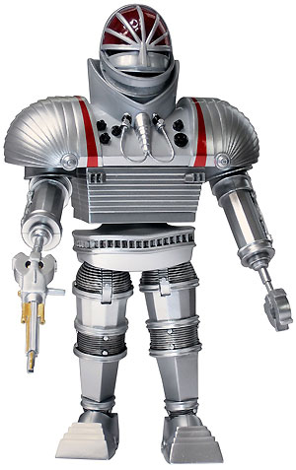
Motivated Learning Embodied Cognitive (MLECOG) Agents
Act autonomously in the environment.
Are motivated to act and learn.
Create internal goals.
Use saccades for attention switching.
Focus attention.
Build object representations.
Create episodic memories.
Learn motor functions.
Have many applications in industry.
http://onceuponageek.com/2008/09/25/doctor-who-classic-action-figures-finally-ship/
Notes:
Give some example of biologically inspired designs?

Slide 4
MLECOG agents
Sensory-motor area
Motivations and goal creation
Semantic memory
Episodic memory
Motor control
Visual saccades
Attention switching
Working memory
Working memory functions
  Action planning
  Action evaluation
  Action monitoring
  Scene building
  Episodic
  management
  Mental saccades
  Attention focus
http://onceuponageek.com/2008/09/25/doctor-who-classic-action-figures-finally-ship/
Notes:
Give some example of biologically inspired designs?

Slide 5
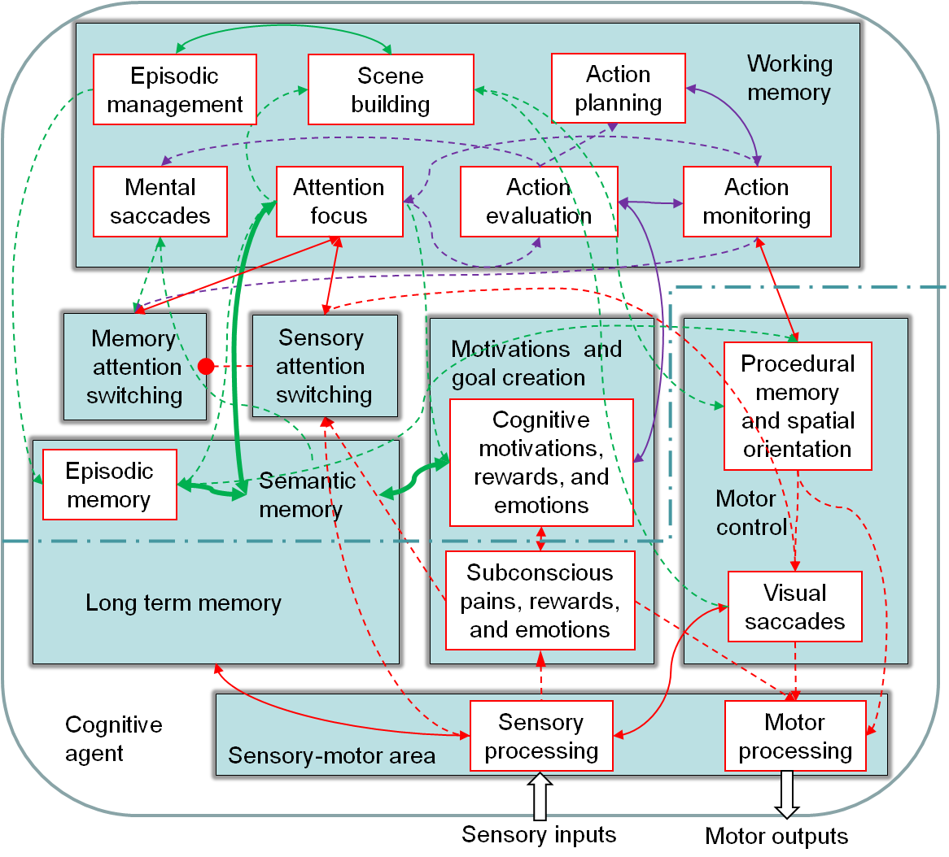
MLECOG agent building blocks
http://onceuponageek.com/2008/09/25/doctor-who-classic-action-figures-finally-ship/
Notes:
Give some example of biologically inspired designs?

Slide 6
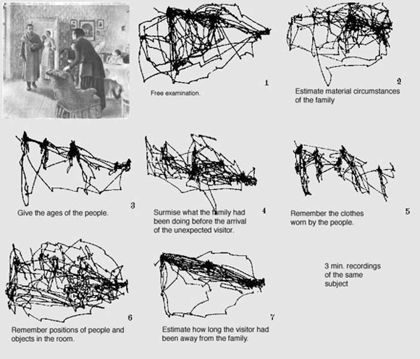
Visual saccades
Rapid movement of eyes, head, or optical devices
Initiated either consciously or subconsciously
Serves as a mechanism for focusing the visual attention
Humans alternate saccades and visual fixations
http://www.learning-to-see.co.uk/images/composition/yarbus-task-based.gif

Slide 7
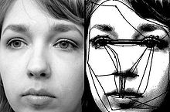
Visual saccades
Salient regions are found through competition among neurons
After the winning neurons are inhibited, the next most prominent salient location is automatically selected
Saccadic movements repeatedly revisit the same locations with a high saliency while reconstructing the whole scene
A significant portion of visual saccades is affected by associations between the observed artifacts
http://en.wikipedia.org/wiki/Saccade

Slide 8
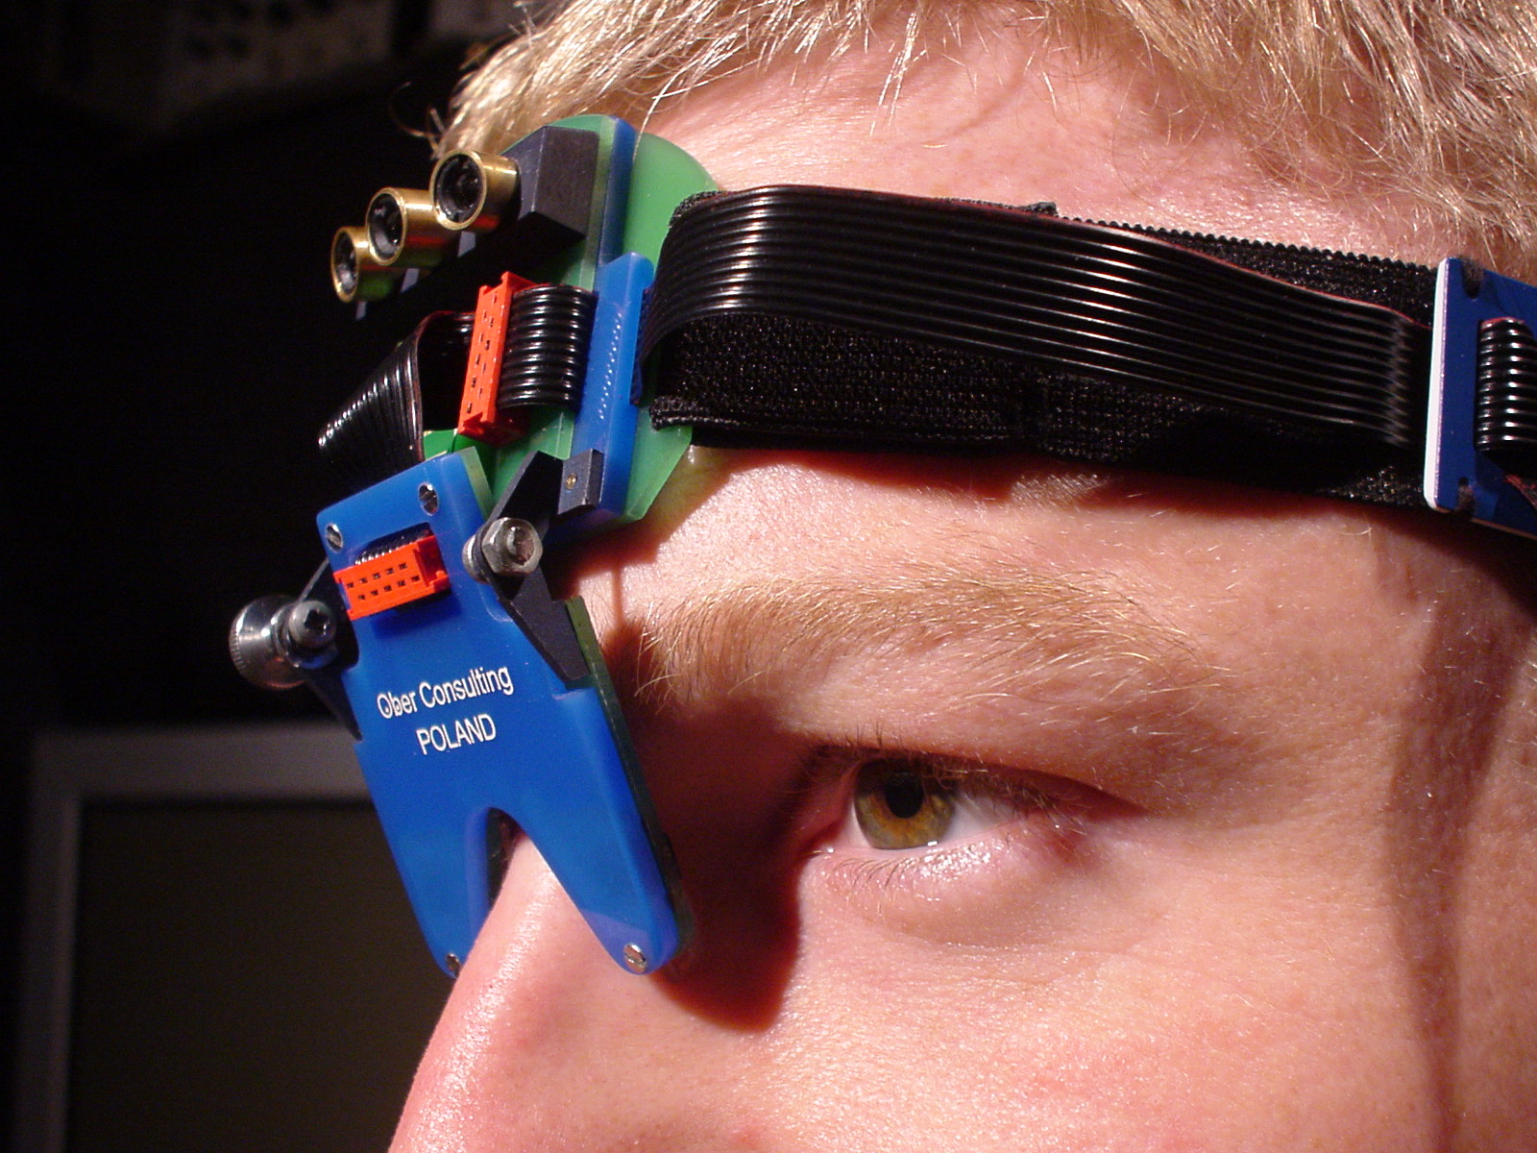
Visual saccades
Help object recognition at a specific location
Saccade location is selected based on a visual saliency
Attention temporarily suppresses stimuli that do not belong to the object in attention focus
Temporal binding provided by attention binds the activated groups of neurons forming episodic memories
A head-mounted saccadometer with built-in laser target projectors
http://www.neuroscience.cam.ac.uk/directory/profile.php?RogerCarpenter

Slide 9
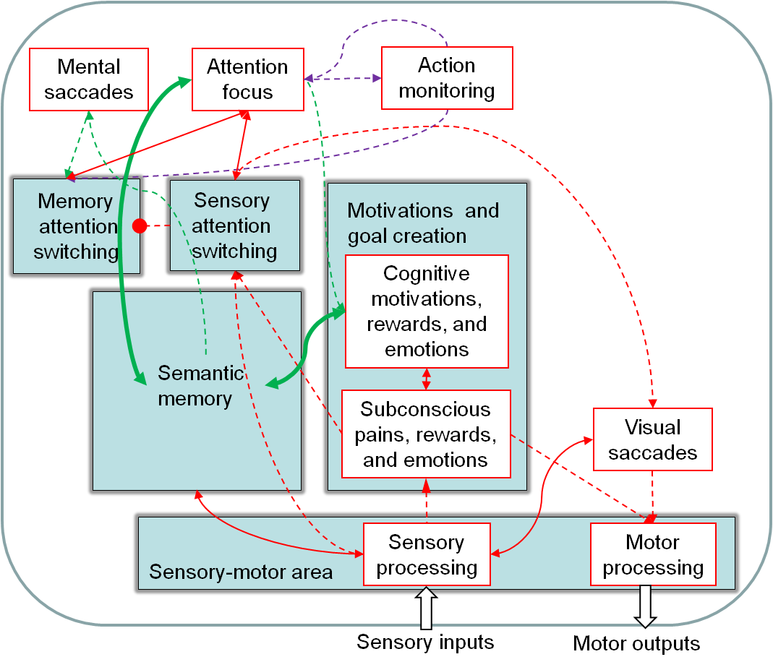
Sensory attention switching

Slide 10
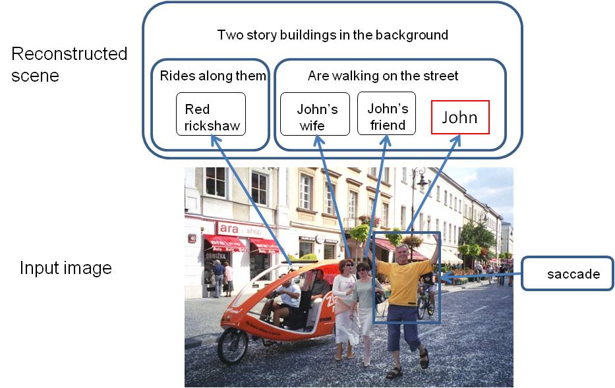
An observed scene and its reconstructed elements

Slide 11




Saccades through Gaussian match
.
Characterize and locate objects in 2D image plane using
Parameters μ and Σ are chosen to maximize similarity S
To find the optimum values of μ and Σ we calculate

Slide 12




Saccades through Gaussian match
.
,
Solving for the optimum values of μ we get:
In a similar way we get
That yields

Slide 13
Convergence of the covariance matrix and the mean values

Slide 14
Object characterization algorithm
Normalize the object image and remove background.
Position the normalized object image in a scene.
Fit best Gaussian function to obtain object location
μ_{ο} in the scene.
Obtain covariance matrix Σ_{ο} of its best fitting Gaussian function and similarity S_{o} measure between the normalized image and this Gaussian.
The object image is characterized by μ_{ο ,} Σ_{ο} and S_{o} .

Slide 15

Example
The normalized object image is characterized by

Slide 16



Finding scale and rotation
Find the covariance matrix Σ_{G} of the Gaussian that best characterize the observed object
Use diagonalization of the matrix Σ_{G} to get
The rotation matrix
The rotation angle is
The scale factors are and

Slide 17

Object identification algorithm
Locate an image in a scene using saccade motion.
Use Σ_{L} to find scale matrix Λ_{L} and rotation angle θ_{L}.
Find similarity measure S of the Gaussian and the object image found in this location.
For each similar memory object O_{M} similar do:
  Place O_{M} at the location found.
  Scale the object using the scale matrix Λ_{L}.
  Rotate the object using the rotation angle .
  Find similarity between the transformed O_{M} and the image.
Matching error is computed as the ratio

Slide 18



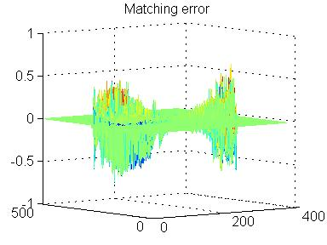
Example
The best fitting Gaussian function was obtained with
The scale factors
and
and the rotation angle is
The original image was scaled by 1.1 and rotated by 60º

Slide 19
Conclusion and future work
Developed quick characterization and location of the object image
  Implementation of visual saccades idea for object recognition.
  Image is described based on the mean value and the covariance matrix of a 2D Gaussian function.
Similarity measure between the best Gaussian fit and the observed object is used for object characterization
  Memorized objects that have specific Gaussian similarity are extracted from the memory
  After proper rotation and scale, target objects are placed in the identified location for recognition

Slide 20
Conclusion and future work
Equations that solve the optimization problem to find the most similar Gaussian are solved explicitly
  Exponentially fast convergence.
  Object location, its scale, and rotation can be quickly computed.
This approach can be applied either to the entire image, its parts, or to a complex scene
  Inhibition of previously visited areas of the image will force saccadic searches
  Future work is to test this concept in realistic scenes
    Build hierarchical object representations in memory.
    Apply various resolution levels to minimize the processing time.

Slide 21

Questions?

Slide 22
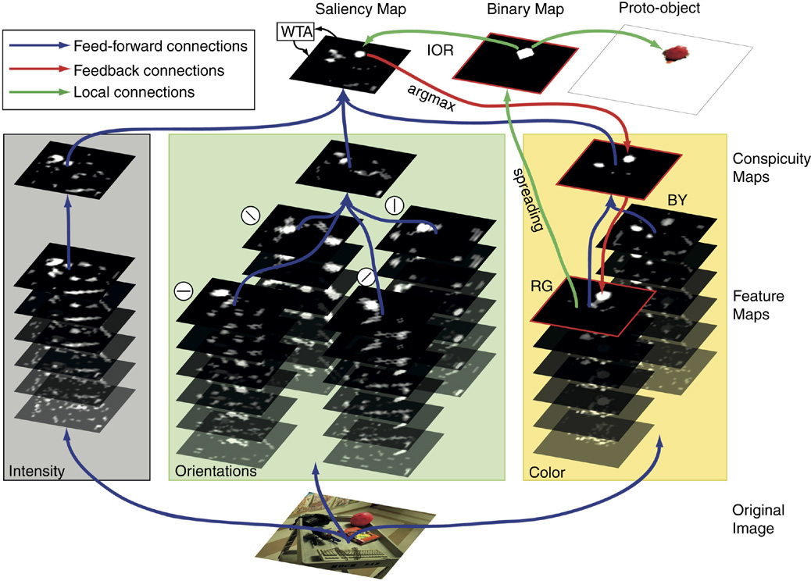
Saliency based selection of object location
D. Walther and C.Koch (2006) Modeling attention to salient proto-objects, Neural Networks,

Slide 23
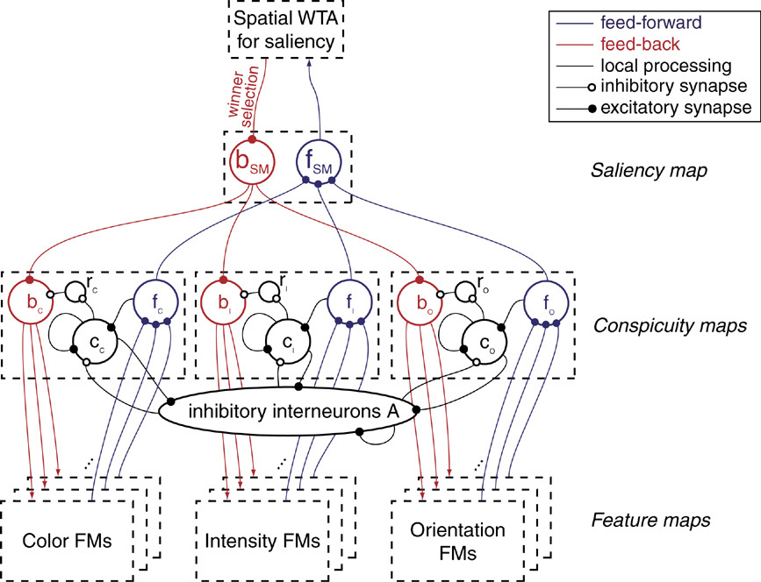
Saliency based selection of object location
D. Walther and C.Koch (2006) Modeling attention to salient proto-objects, Neural Networks,

Slide 24
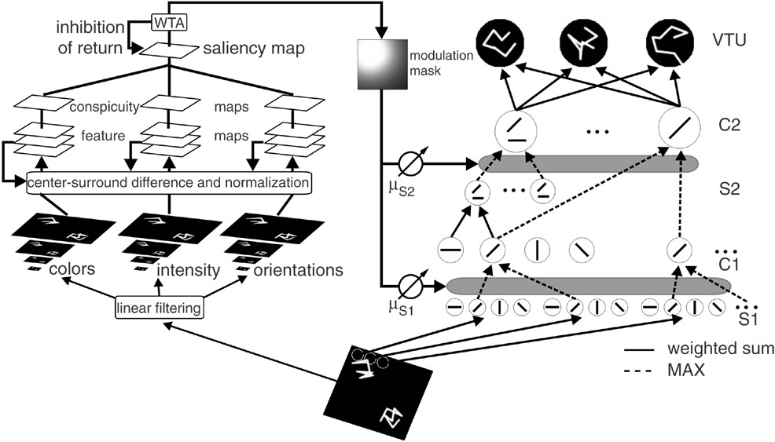
Attentional modulation in object recognition
M. Riesenhuber and T. Poggio, (2003). How visual cortex recognizes objects. The visual neurosciences

Slide 25
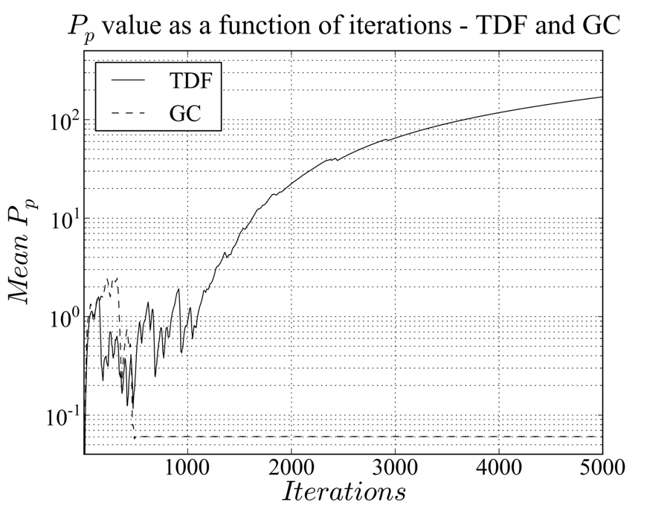
Reinforcement Learning vs. Motivated Learning – cont.
This is a pain plot comparing
TD-Falcon (a RL algorithm) and an early version of the ML algorithm in a hostile environment.
Note, that while TDF initially does better than the ML algorithm, circumstances quickly reverse.
J. A. Starzyk, J. T. Graham, P. Raif, and A-H. Tan, “Motivated Learning for Autonomous Robots Development”, Special issue on Computational Modeling and Application, Cognitive Systems Research v.14, no.1, 2012, p.10(16) pp. 10-25.

Slide 26
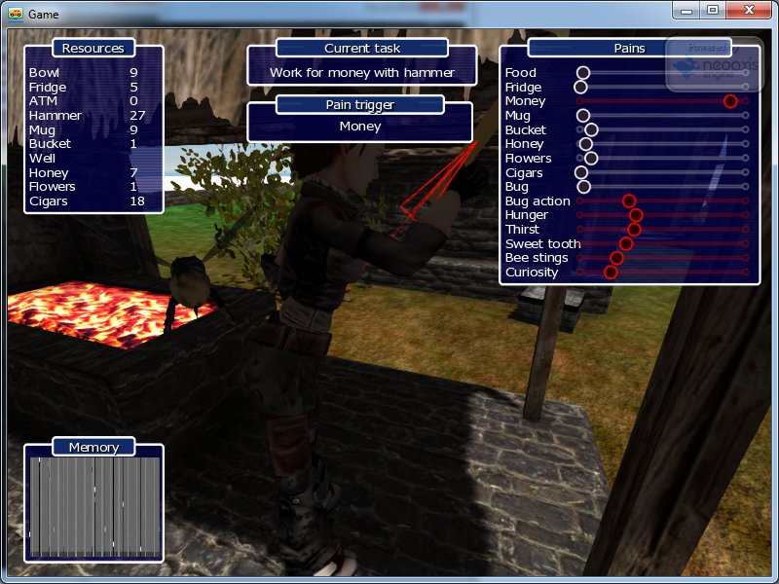
Agent works with a Hammer

Slide 27
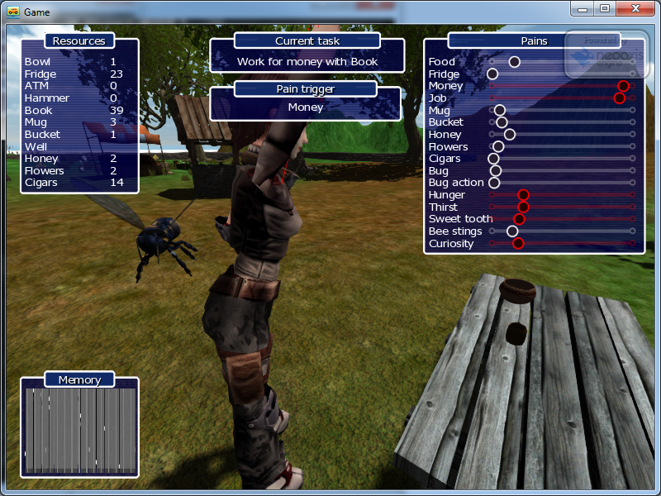
Book resource was introduced

Slide 28
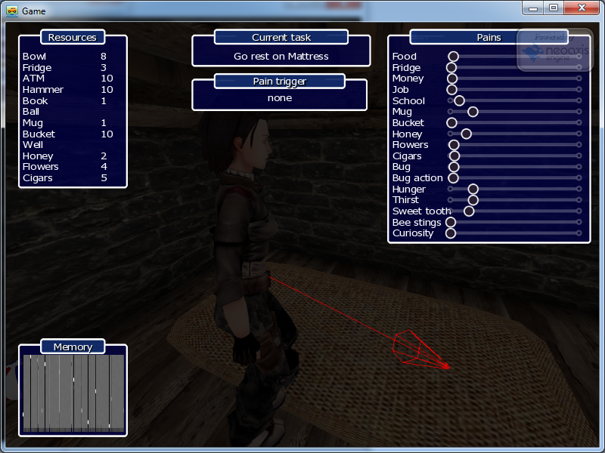
Agent learned all environment and goes to sleep

