Slide 1
Emergent Creativity in Declarative Memories
A. Horzyk, J. A. Starzyk, and Basawaraj

Slide 2
Content
Introduction
Associative Neurons
Semantic Memory
Episodic Memory
Declarative Memory
Emergent Creativity
Conclusion
http://pathave.com/learnsleep/

Slide 3
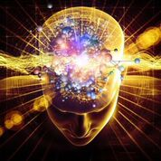
Introduction
Intelligence is the ability to learn from experience
and use the acquired knowledge to adapt to one's
environment and reach goals.
Intelligence enables:
Acquire and store knowledge
Contextually associate knowledge
Make generalizations and draw conclusions
Recall memories and apply knowledge to solve novel goals
Intelligence requires:
Sensory and motor abilities
Memory, semantic and episodic
Mechanism to store and associate information to form knowledge
Motivations to act

Slide 4
Knowledge Gathering
Problem: Associative mechanisms needed to “form” knowledge from “observed facts” and experiences
Solution: Use associative neural graphs!
Why associative neural graphs?
Can be used to store and recall sequential memories
Form associations between “facts”
Consider temporal order and context of events
Sensory and motor abilities?
Beyond the scope of this work
http://animcreation.e-monsite.com/pages/animations/

Slide 5
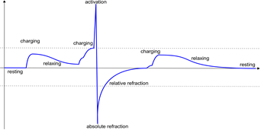
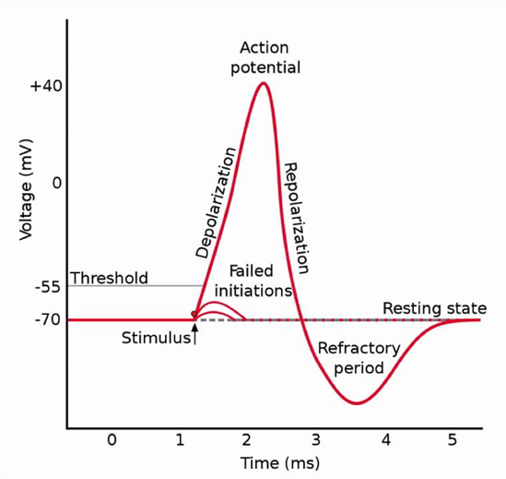
Associative Neuron
How to model a neuron?
Use biological neurons as reference.
Why biological neurons? Efficient and robust.
Connections between biological neurons automatically strengthened if activation of one leads to activation of another within short intervals and weakened if another neuron is triggered after longer delay

Slide 6
Associative neuron excitation levels
http://biomedicalengineering.yolasite.com/neurons.php

Slide 7
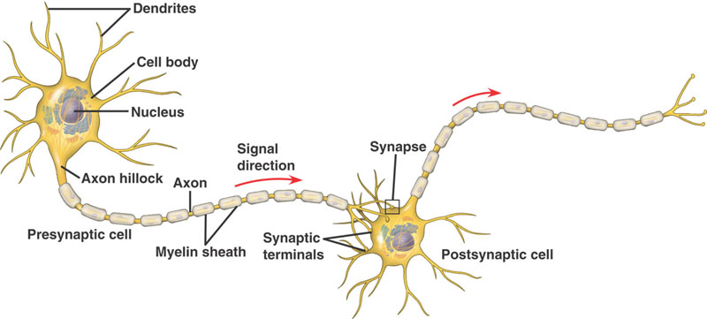
Synaptic weight
Synaptic weight $w=b c m$
$b$ behavior factor that determines synapse influence on postsynaptic neuron ($b=1$ when influence is excitatory and $b=−1$ when inhibitory),
$c$ synaptic permeability and is computed using
Linear permeability: $c=\frac{η}{2η− δ}$
Square root permeability: $c=\frac{\sqrt{ηδ}}{\sqrt{ηδ}+η− δ}$
Quadratic permeability: $c=\frac{ηδ}{ηδ+η^{2}− δ^{2}}$
Proportional permeability: $c=\frac{δ}{η}$
Power permeability: $c={\left(\frac{δ}{η}\right)}^{\frac{1}{k}}$
$η$ number of activations of a presynaptic neuron during training
$δ$synaptic efficiency computed for this synapse
k>1 is an integer.
$m$ multiplication factor and is computed using: $m=\frac{θ_{N_{i}}^{t}}{X_{N_{i}}^{S_{1}+…{+S}_{L}}}−\frac{x^{LAST}}{2}$
$θ_{N_{i}^{n}}$ is the activation threshold of postsynaptic neuron
$x^{LAST}$ last postsynaptic stimulation
Only limitation is $m≤θ_{N_{i}}^{t}$
http://biomedicalengineering.yolasite.com/neurons.php

Slide 8
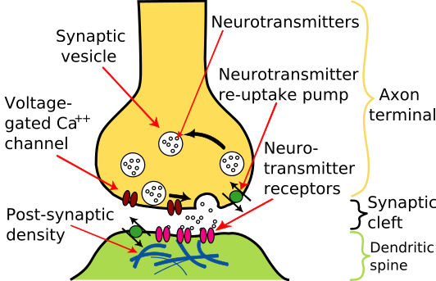
Synaptic efficiency
Presynaptic influence is determined by the synaptic efficiency of a synapse between neurons $N_{m}→N_{i}$ and is defined as:
$∆t^{A}$ time between stimulation of synapse and activation of postsynaptic neuron
$∆t^{C}$ time to charge and activate postsynaptic neuron after stimulating synapse
$∆t^{R}$ period for postsynaptic neuron to relax and return to resting state
$γ$ context influence factor changing the influence of the previously activated and connected neurons on the postsynaptic neuron $N_{i}$
$S^{n}$ training sequence during which activations were observed
$𝕊$ the set of all training sequences used
$$δ_{N_{m},N_{i}}=\sum_{\left\{\left(N_{m},N_{i}\right)∈ S^{n}∈ 𝕊\right\}}{{\left(\frac{1}{1+\frac{∆t^{A}−\min\left(∆t^{C}, ∆t^{A} \right)}{∆t^{R}}}\right)}^{γ}}$$
http://www.wikiwand.com/nl/Synaps

Slide 9
Synaptic efficiency
Presynaptic influence is determined by the synaptic efficiency of a synapse between neurons $N_{m}→N_{i}$ and is defined as:
$∆t^{A}$ time between stimulation of synapse and activation of postsynaptic neuron
$∆t^{C}$ time to charge and activate postsynaptic neuron after stimulating synapse
$∆t^{R}$ period for postsynaptic neuron to relax and return to resting state
$γ$ context influence factor changing the influence of the previously activated and connected neurons on the postsynaptic neuron $N_{i}$
$S^{n}$ training sequence during which activations were observed
$𝕊$ the set of all training sequences used
$$δ_{N_{m},N_{i}}=\sum_{\left\{\left(N_{m},N_{i}\right)∈ S^{n}∈ 𝕊\right\}}{{\left(\frac{1}{1+\frac{∆t^{A}−\min\left(∆t^{C}, ∆t^{A} \right)}{∆t^{R}}}\right)}^{γ}}$$
http://www.wikiwand.com/nl/Synaps

Slide 10
Semantic Memory
Structured record of facts, meanings, concepts and knowledge about the world
General factual knowledge, shared with others and independent of personal experience and of the spatial/temporal context in which it was acquired.
May once have had a personal context, but now stand alone as general knowledge.
E.g. types of food, capital cities, social customs, functions of objects, vocabulary, etc.
Abstract and relational
Representation is obtained through symbol grounding, associating sensory data with action and reward obtained by the system in its interaction with the environment.
Uses an active neuro-associative knowledge graph (ANAKG) – that can represent and associate training sequences of objects or classes of objects.
Synaptic connections are weighted, each association has its own importance.
Can provide common sense solutions to new situations that were not experienced before.

Slide 11
Building Semantic Memory
Example
Semantic memory was built using a number of training sequences.
Training sequences:
I have a monkey.
My monkey is very small.
It is very lovely.
It likes to sit on my head.
It can jump very quickly.
It is also very clever.
It learns quickly.
My monkey is lovely.
My son has a small dog.
His dog is white and sweet.
My daughter has a black cat.
Her cat is small and clever.
http://www.livescience.com/42920-semantic-memory.html

Slide 12
Associative Construction Process of the Semantic Memory
The succession of activations is an important connection plasticity factor that establishes new associations between represented objects!
Notes:
This slide shows real time learning and self organization of the semantic memory based on the provided training examples in which each word is represented by a single neuron.
Different colors show activation of neurons and how these activations change due to associative links and passage of time.
After external activation neuron fires (red color) and changes both synaptic strength and activation level of associated neurons (marked in green).
After each firing neuron goes through a refraction period (marked in blue) during which it cannot be activated.
New neurons are added to the associative graph as needed (when no such symbol was observed before)

Slide 13
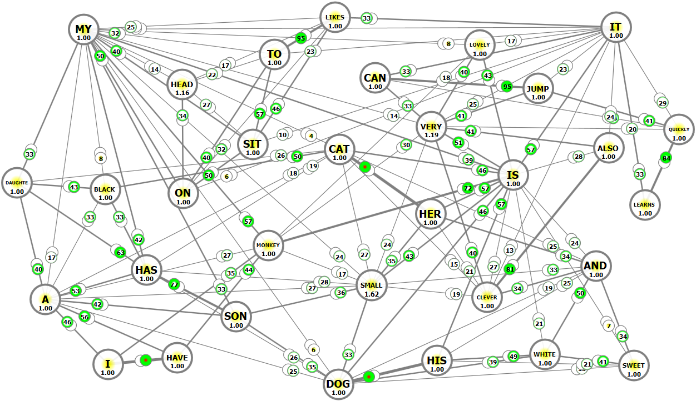
Semantic Memory Network
Results from self-organization of an associative neural network, by adding neurons and their connections:
Nodes represent concepts and edges represent spatio-temporal associations that can be used to activate other concepts.
Symbol grounding and learning of complex motor functions is based on finding critical perceptual information about objects.

Slide 14
Using Semantic Memory
Possible to retrieve information for given contexts and to generalize learned information or get creative responses.
Recalls training sequences when the initial context is unique.
When context is new or not unique achieves new or generalized answers.
Repetition of not unique contexts leads to recalling the most frequent subsequences from the training data.
Initial context / Question | Network Answer
I have (a unique context) | I have a monkey
Her (a unique context) | Her cat is small and clever
His (a unique context) | His dog is white and sweet
My (no unique context) | My
My monkey (repeated 5 times) | My monkey is small very lovely
Monkey is (repeated 3 times) | Monkey is very small lovely
Cat (repeated 5 times) | Cat is small
Dog (repeated 3 times) | Dog is white
It (repeated 6 times) | It is very lovely
My son and his dog | My son has a small dog and his is white sweet dog
Can I | Can I have a monkey

Slide 15
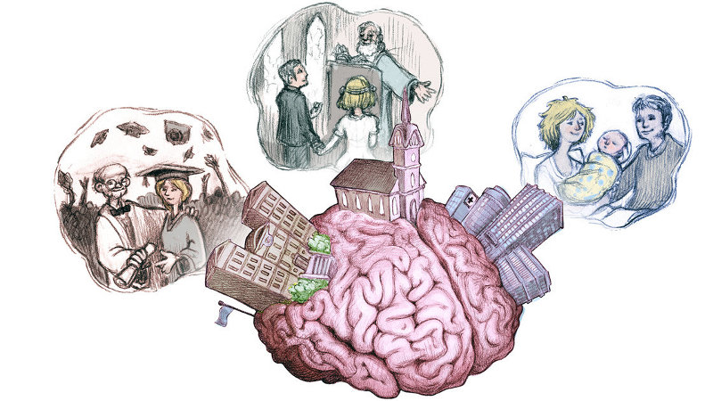
Episodic Memory
Represents memory of experiences and specific events in time in a sequential form.
Episodic memory gives us time perspective and provides continuity in everyday activities
http://news.softpedia.com/news/The-Brain-Can-Geotag-Our-Memories-404541.shtml
Can reconstruct the actual events that took place at any given point.
Memory of autobiographical events that can be explicitly stated.
times, places, associated emotions and other contextual knowledge
Individuals tend to see themselves as actors in these events
emotional charge and context surrounding an event is part of the memory, not just the bare facts of the event itself.
Can be used for path finding, sequential associative learning (speech, motor control), and recollection of cognitively observed events.
Significance has a strong influence over the strength and durability.
Uses a flexible matching mechanism that measures similarity between the learnt and tested sequences.

Slide 16
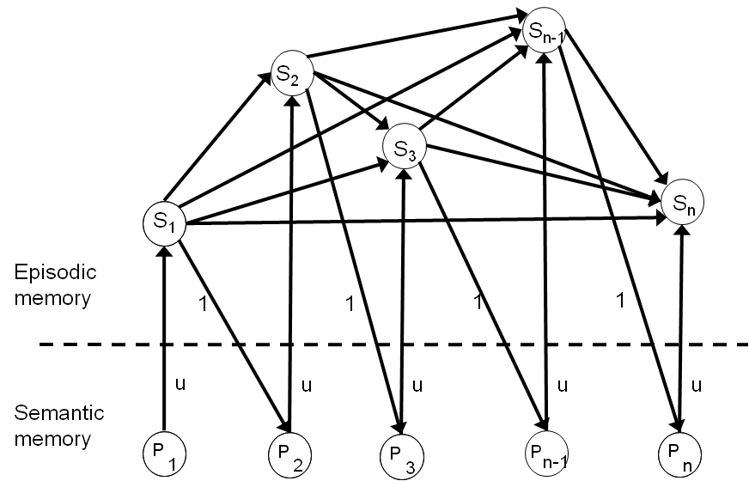
Episodic Memory
Tolerates errors or presentation order, distortion of the observed scene, and varying time delay.
It is a self-organizing structure of long term memory (LTM) cells.
Primary neurons in the semantic memory are sequentially activated.
Activations stimulate corresponding secondary neurons

Slide 17
Retrieval of Episodic Memory
Episodic memory is activated during a sequence recognition process.
The memory retrieval involves three stages:
event detection,
episode recognition, and
episode recall.
Event detection is triggered by activation of primary neurons and associated neurons in the semantic memory.
Episodes are recognized by activation of LTM cell neurons.
the cell that was activated first represents the observed episode.
The episodic recall plays an important role in learning, by anticipating the expected events.
If the anticipation was correct – no learning takes place.

Slide 18
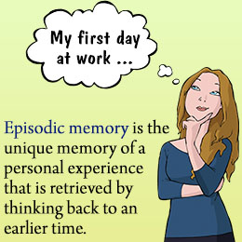
Retrieval of Episodic Memory
Memory retrieval algorithm is as follows:
Activate primary neurons and the corresponding secondary neurons in all LTM cells.
Compute an activation level of the secondary neurons.
Use the secondary neuron with the strongest activation to find the winning LTM.
Secondary neuron of the winning LTM cell predicts the next episode.

Slide 19
Testing of Episodic Memory
Useful to recall past events based on context
In the integrated memory system the context is provided by semantic memory
Cells in episodic memory represents episodes and secondary neurons represent individual events.
Input triggers primary neurons in semantic memory and those trigger the corresponding secondary neurons.
The semantic and episodic memories
are created from training sequences
using associative neurons
http://www.hoodedutilitarian.com/2011/03/tcj-mb-r-i-p/
Notes:
Details of testing the episodic memory are presented in the paper.

Slide 20
Emergent Creativity of Declarative Memory
Two types of long-term memory: explicit (or declarative) memory and implicit (or procedural) memory.
Declarative memory is an integration of semantic and episodic memories.
Created events are obtained within a context of observed events.
This can be used to answer questions based on the stored knowledge and observed use of language.
No explicit grammar rules are needed
Natural way of learning language
If many answers could be derived, declarative memory chooses the most typical ones.
Associations in declarative memories result in mental saccades.
Changing context may result in changing the answer, creating new sequences of events that were not previously observed.
This reflects creativity determined by dynamically modified knowledge gained during training.

Slide 21
Simulation of Declarative Memory
Table shows answers provided by the declarative memory
As the individual neurons start a relaxing or refraction phase the winning LTM cells can change.
Only the winning LTM cell is specified.
Semantic memory provides associations and context to the recalled episodes.
Initial context / Question | Declarative Memory Answers
I have | I have a monkey
Her | Her cat is small and clever
His | His dog is white and sweet
My | My monkey is lovely.
My monkey | My monkey is lovely.
Monkey is | My monkey is lovely.
Cat | Her cat is small and clever.
Dog | His dog is white and sweet.
It | It learns quickly.

Slide 22
Conclusion
We developed and tested a structural organization of declarative memories using a new model of dynamic associative neurons.
Associative neurons were modified to accommodate growth and sensitivity of neurons that resulted in automatic threshold changes and specialization of neurons.
The same neurons can be activated by various combinations of input stimuli that represent various contexts of input sequences.
We investigated neuron’s fatigue and the effect of synaptic weight sensitivity on overall activity of neurons in the obtained memories.
We tested sequence recognition and associative properties of the obtained declarative memory.
We observed emergent creativity in the developed memories.
Future work includes adding autonomous motivational signals and mechanisms of their automatic associations with symbols and actions.

Slide 23
Questions?

