Slide 1
Trust in Motivated Learning Agents
James Graham¹, Janusz A. Starzyk^{1,2}, Adrian Horzyk³
¹School of Electrical Engineering and Computer Science
Ohio University, Athens, OH, USA
²University of Information Technology and Management
Rzeszow, Poland
³Department of Automatics and Biomedical Engineering,
AGH University of Science and Technology, Krakow, Poland

Slide 2
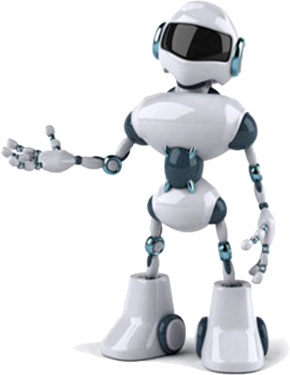
Overview
Introduction
Background
  Motivated Learning
  Needs and Motivation
  Trust
Trust in ML
Developing Trust
Using Trust in ML
Results
Conclusions
Notes:
Give some example of biologically inspired designs?

Slide 3
Motivated Learning
Controlled by underlying “primitive” motivations
Builds on motivations to create additional “abstract” needs/motivations
Motivation Hierarchy
Unlike in RL, focus is not on maximizing externally set rewards, but on intrinsic rewards and creating mission related new goals and motivations.
Intrinsic
Intrinsic
Intrinsic
Extrinsic
Notes:
General purpose? What machine learning is used for.
ML is part of machine learning.
Autonomous learning, rovers, etc.

Slide 4
Needs and Motivation
Needs are the most important motivation factor.
Needs can have different strength:
  Excited – when they grow
  Inhibited – when they weaken
Needs can be variously satisfied:
  Fulfilled – when often met
  Depleted – when rarely met
Satisfaction can
significantly influence
the degree of trust
and confidence

Slide 5
Trust
Trust plays a role in relationships between individuals, groups, and their environments.
It impacts the decision making process.
  Can speed up the decision making process
  e.g. if someone is trusted (or not) a decision can be made more quickly regarding an associated choice
Trust can be considered a personality trait
  How and what people trust can be part of their character
  People tend to give more trust to those whose characters match their own.

Slide 6
Trust in the Context of Needs
Depletion of fulfilling needs can may lead to:
  changes of action priorities
  changes of reaction to various stimulus
  stronger desire for satisfaction
  reduction of trust to
  the plaintiff of depletion

Slide 7
Trust in View of Personality
People usually place more trust in other people of the same personality traits because they usually:
  understand their needs and goals
  anticipate their next steps
  understand their reactions and reasons
  easier take cooperation

Slide 8
Trust in Motivated Learning
How does a machine develop trust?
Intelligent agents tend to exist in complicated environments.
An agent learns consequences of its and NAC actions.
Providing a teacher can speed up learning.
What are developmental benefits of trust?
  Trusting or distrusting another agent (e.g. the teacher) can be beneficial.
  Our goal is to demonstrate this.
Notes:
Measures presented in next slide

Slide 9
Trust in Motivated Learning– cont.
In ML an agent develops a bias for or against actions by other agents (NACs or Non-Agent Characters).
NAC actions are desirable, undesirable, or neutral.
There can be a large number of possible NAC actions in an environment.
Action desirability can be closely related to trust
  Trust is developed after experiencing helpful actions
  Distrust is developed after harmful actions
The degree of trust/distrust developed depends on character traits and experience.
Notes:
Measures presented in next slide

Slide 10
Motivated Learning– cont.
Availability based bias
R_{d} is a desired resource value (at a sensory input s_{i})
R_{c} is a current resource value
A is the Availability calculation
d_{c} is the current distance to another agent
d_{d} is a desired (a comfortable) distance to another agent
Notes:
A bias signal triggers an abstract pain and is defined depending on the type of perceived situation.
Bias reflects the level of need associated with the resource/action
Bias based on availability is more general than than calculated strictly for an action or a resource. It can also be adjusted for desirability.

Slide 11
Motivated Learning– cont.
Once a bias is evaluated and NAC action pain is triggered, an agent can learn the w_{bp} weights and properly respond to associated NAC actions.
While distance based bias/pain is used here, other functions are acceptable as long as they properly impact bias signals.
Notes:
Measures presented in next slide

Slide 12
Developing Trust
In ML trust towards individual agents is associated with NACs actions.
  If most NAC actions are desirable it is trusted
  If most NAC actions are undesirable it is distrusted
This generalizes ML from learning to use resources and respond to NAC actions to the early stages of developing trust and cooperation.
Trust has a potential of accepting another agent as a teacher.
Agents may be differentiated by how easily they trust (or not)
Notes:
Measures presented in next slide

Slide 13
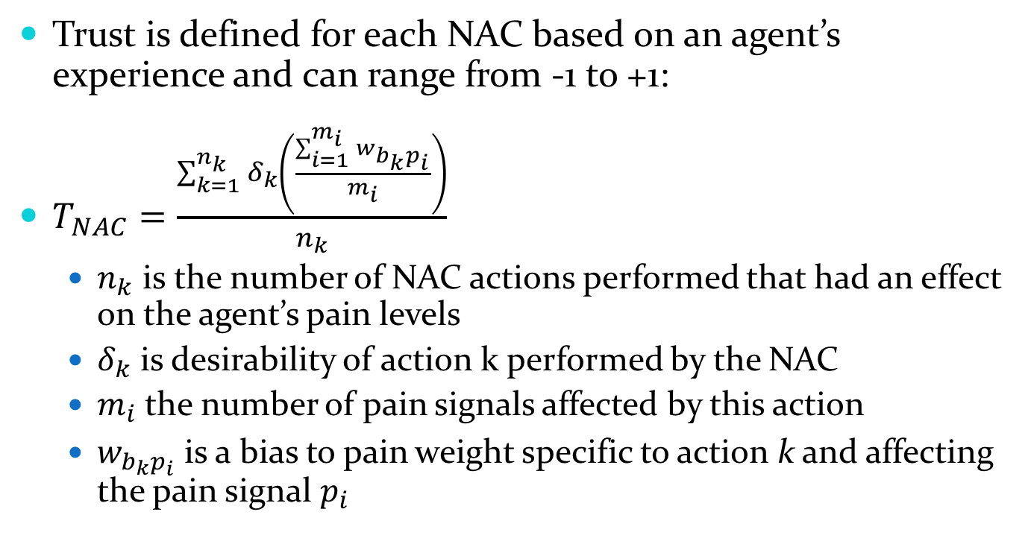
Developing Trust – cont.
Trust is defined for each NAC based on an agent’s experience and can range from -1 to +1:
$T_{NAC}=\frac{\sum_{k=1}^{n_{k}}{δ_{k}\left(\frac{\sum_{i=1}^{m_{i}}{w_{b_{k}p_{i}}}}{m_{i}}\right)}}{n_{k}}$
  $n_{k}$ is the number of NAC actions performed that had an effect on the agent’s pain levels
  $δ_{k}$ is desirability of action k performed by the NAC
  $m_{i}$ the number of pain signals affected by this action
  $w_{b_{k}p_{i}}$ is a bias to pain weight specific to action k and affecting the pain signal $p_{i}$
Notes:
Measures presented in next slide

Slide 14
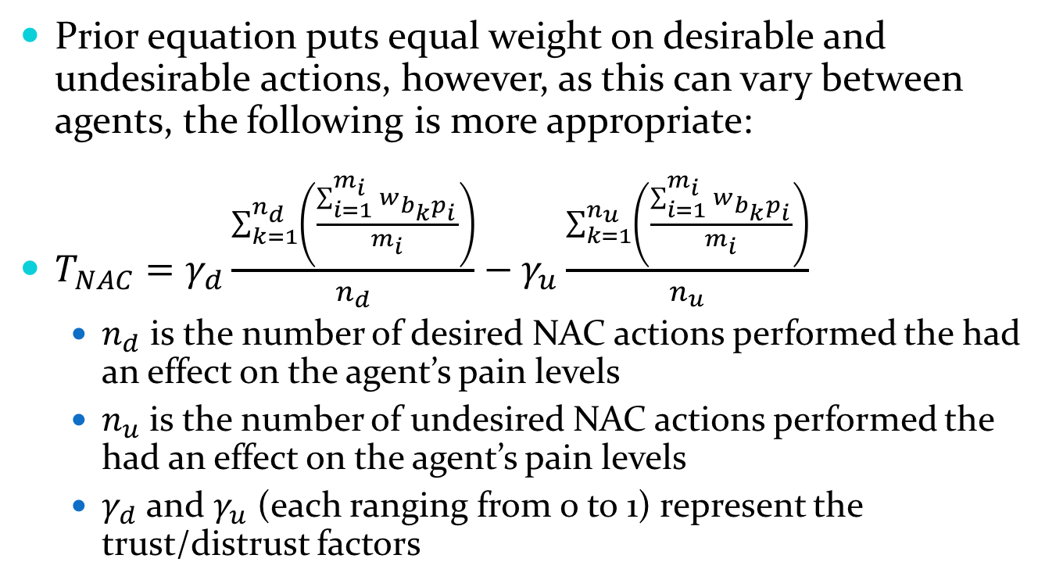
Developing Trust – cont.
Prior equation puts equal weight on desirable and undesirable actions, however, as this can vary between agents, the following is more appropriate:
$T_{NAC}=γ_{d}\frac{\sum_{k=1}^{n_{d}}{\left(\frac{\sum_{i=1}^{m_{i}}{w_{b_{k}p_{i}}}}{m_{i}}\right)}}{n_{d}}−γ_{u}\frac{\sum_{k=1}^{n_{u}}{\left(\frac{\sum_{i=1}^{m_{i}}{w_{b_{k}p_{i}}}}{m_{i}}\right)}}{n_{u}}$
  $n_{d}$ is the number of desired NAC actions performed the had an effect on the agent’s pain levels
  $n_{u}$ is the number of undesired NAC actions performed the had an effect on the agent’s pain levels
  $γ_{d}$ and $γ_{u}$ (each ranging from 0 to 1) represent the trust/distrust factors
Notes:
Measures presented in next slide

Slide 15
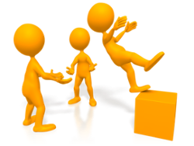
Using Trust in ML
We adapted our basic ML algorithm to develop “trust” using the previous equations.
Several scenarios with varying NACs and trust parameters were developed and tested.
  Different NACs with different levels of trustworthiness
  Varying rates at developing trust in the agent
Two separate experiments
were performed
http://www.bitglass.com/blog/why-trust-employer-to-keep-personal-information-private
Notes:
Measures presented in next slide

Slide 16
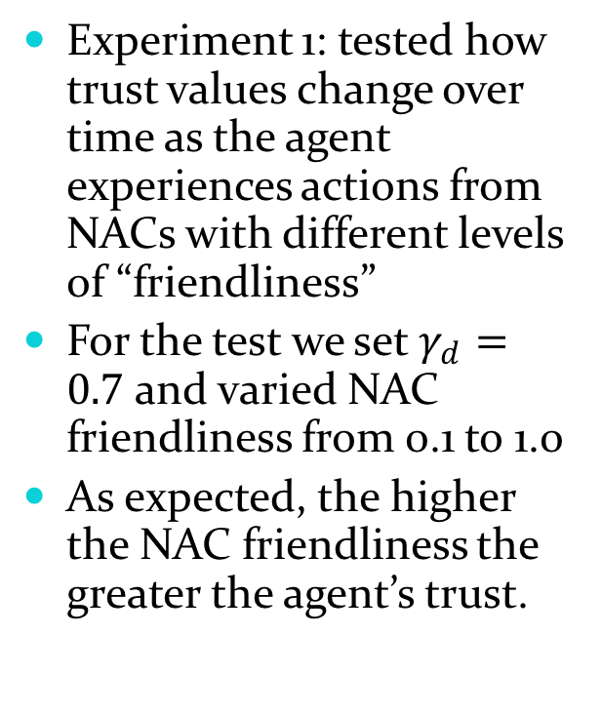
Using Trust in ML – cont.
Experiment 1: tested how trust values change over time as the agent experiences actions from NACs with different levels of “friendliness”
For the test we set $γ_{d}=0.7$ and varied NAC friendliness from 0.1 to 1.0
As expected, the higher the NAC friendliness the greater the agent’s trust.
Notes:
Measures presented in next slide

Slide 17
Using Trust in ML – cont.
Here the maximum reward possible is normalized to 1.0 and punishment to -1.0
Utilizing trust, the agent did not allow unfriendly NACs to hurt it, limiting punishment to -0.2.
Notes:
Measures presented in next slide

Slide 18
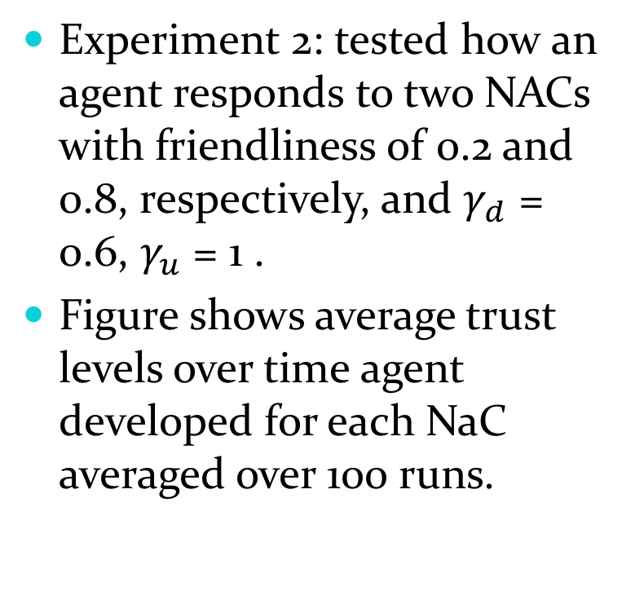
Using Trust in ML – cont.
Experiment 2: tested how an agent responds to two NACs with friendliness of 0.2 and 0.8, respectively, and $γ_{d}$ = 0.6, $γ_{u}$ = 1 .
Figure shows average trust levels over time agent developed for each NaC averaged over 100 runs.
Notes:
Repeated 100 X

Slide 19
Using Trust in ML – cont.
This figure shows the averaged normalized reward received for the agent in experiment 2 when trust is utilized and without trust.
Dotted lines represent confidence intervals of 2 standard deviations.
Notes:
Repeated 100 X

Slide 20
Using Trust in ML – cont.
Simulation length is extended for several thousand iterations.
Note that the trust value for the friendly NAC gradually increased as it continued to deliver desirable actions, while the mistrust for the first agent was maintained or eased a little
Notes:
Repeated 100 X

Slide 21
Using Trust in ML – cont.
Here we see the average reward without trust start to exceed that in agent with trust at ~2000 iterations.
This is due to the agent without trust learning all actions, both good and bad and blocking accordingly.
The agent with trust capability learned to distrust the NAC and blocked its new actions, even those that were beneficial.
Notes:
Repeated 100 X

Slide 22
Using Trust in ML – cont.
However, if the friendliness of the first NAC is reduced to 0.03, the crossover from the previous figure does not occur
Using trust is always more beneficial than not in this case.
Notes:
Repeated 100 X

Slide 23
Using Trust in ML – cont.
Other characteristics like shyness, bravery, etc., may be developed similarly to trust and could eventually yield a social agent.
An extension of this work will yield a social agent whose interaction with other agents is well regulated through rules that are understood and accepted as useful by the agents.
Intelligent ML agents could be more capable of adapting their behavior to human adversaries than humans, as ML agents can be programmed to recognize and reflect human traits.
Notes:
Measures presented in next slide

Slide 24
Conclusions
This paper introduced a concept of trust in ML agents.
Trust was defined based on experience with NACs and performance was evaluated based on simple reward calculations.
Using trust, the ML agent can benefit in several ways
  By blocking new actions performed by an untrusted NAC. We demonstrated that such a strategy pays off at the initial stage of interaction with NACs.
  Discovered that if interaction time is extended, and the trust measure is higher than 0, it may be better to learn more about the unfriendly NAC and use the knowledge to benefit the ML agent.
  However, all actions by very unfriendly NACs with a very low trust measure should be blocked.
Trust can be considered a natural step to introducing a teacher that would accelerate learning in an ML agent.
Trust is also related to other features of an agent’s character including emotions and various traits of character that modify its behavior.

Slide 25
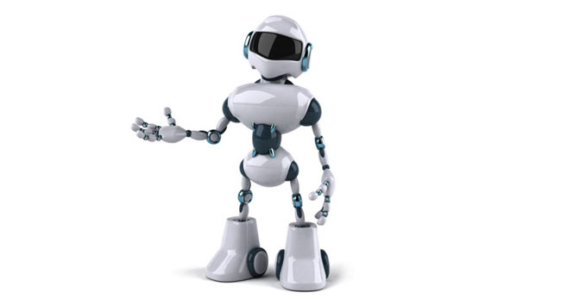
Questions?

Slide 26
Backup slides
Notes:
Shown equation was chosen because it is linear (but won’t hit INF)
A bias signal triggers an abstract pain and is defined depending on the type of perceived situation.
Bias reflects the level of need associated with the resource/action

Slide 27
Bias based on availability and desirability
Bias for a desired resource
Bias for a desired action
Bias for an undesired resource
Bias for an undesired action
Notes:
Shown equation was chosen because it is linear (but won’t hit INF)
In the case of desired resource we want non-zero bias for both too little and to much of a resource. We also prefer “exponential” (nonlinear)” growth of bias for desired situations.
Why use linear calc. for undesired situations?

Slide 28
Learning and selecting actions
Goals are selected based on pain-goal weights:
δ_{p} indicates how the associated pain changed
∆_{a} , outside of μ_{g} ensures the weights stay below the ceiling of α_{g}=1
μ_{g} determines the rate of chance
Notes:
Transition from previous slide. How do we go from bias to action calculation?
Bias is used to calculate pain.
Changes in pain reflect how action affect the agent.
We need to update weights between pain and goals
Weights are used to select actions/goals.

Slide 29
Comparing Reinforcement Learning to Motivated Learning
Compare ML and RL
Reinforcement Learning | Motivated Learning
Single value function | Multiple value functions
Measurable awards | Internal immeasurable rewards
Predictable | Unpredictable
Objectives set by designer | Sets its own (“abstract”) objectives
Maximizes the reward | Solves minimax problem
Potentially unstable | Always stable
Always active | Acts only when needed

