Slide 1

Packaging

Slide 2
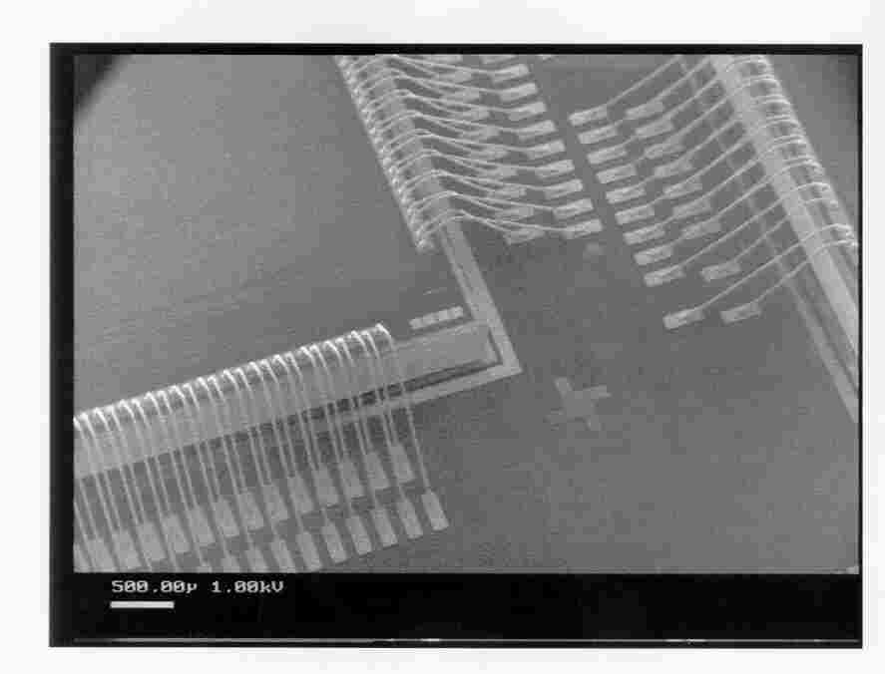
Packaging Requirements
Desired package properties
Electrical: Low parasitics
Mechanical: Reliable and robust
Thermal: Efficient heat removal
Economical: Cheap
Wire bonding
Only periphery of chip available for IO connections
Mechanical bonding of one pin at a time (sequential)
Cooling from back of chip
High inductance (~1nH)
More about packaging:
http://www.embeddedlinks.com/chipdir/package.htm

Slide 3
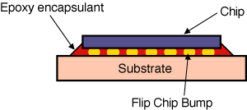
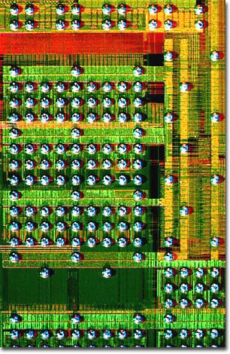
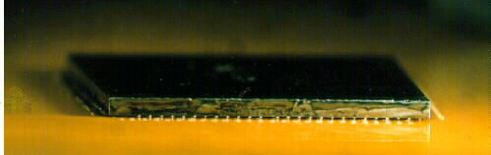
Chip to package connection
Flip-chip
Whole chip area available for IO connections
Automatic alignment
One step process (parallel)
Cooling via balls (front) and back if required
Thermal matching between chip and substrate required
Low inductance (~0.1nH)

Slide 4
Bonding Techniques

Slide 5
Tape-Automated Bonding (TAB)

Slide 6
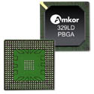

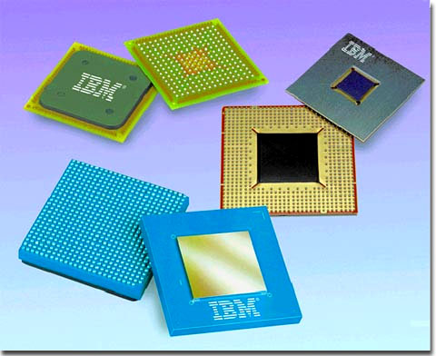
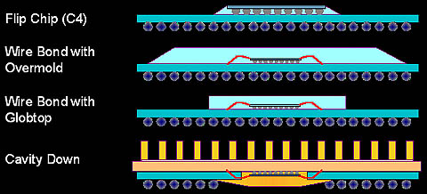
New package types
BGA (Ball Grid Array)
Small solder balls to connect to board
small
High pin count
Cheap
Low inductance
CSP (Chip scale Packaging)
Similar to BGA
Very small packages
Package inductance:
1 - 5 nH

Slide 7
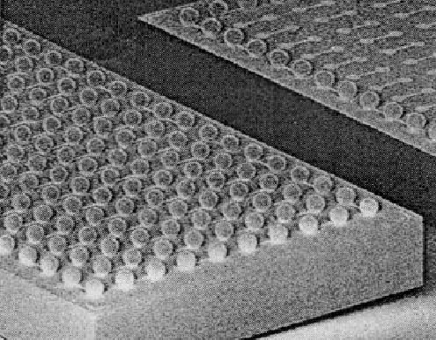
Flip-Chip Bonding

Slide 8
Package-to-Board Interconnect

Slide 9
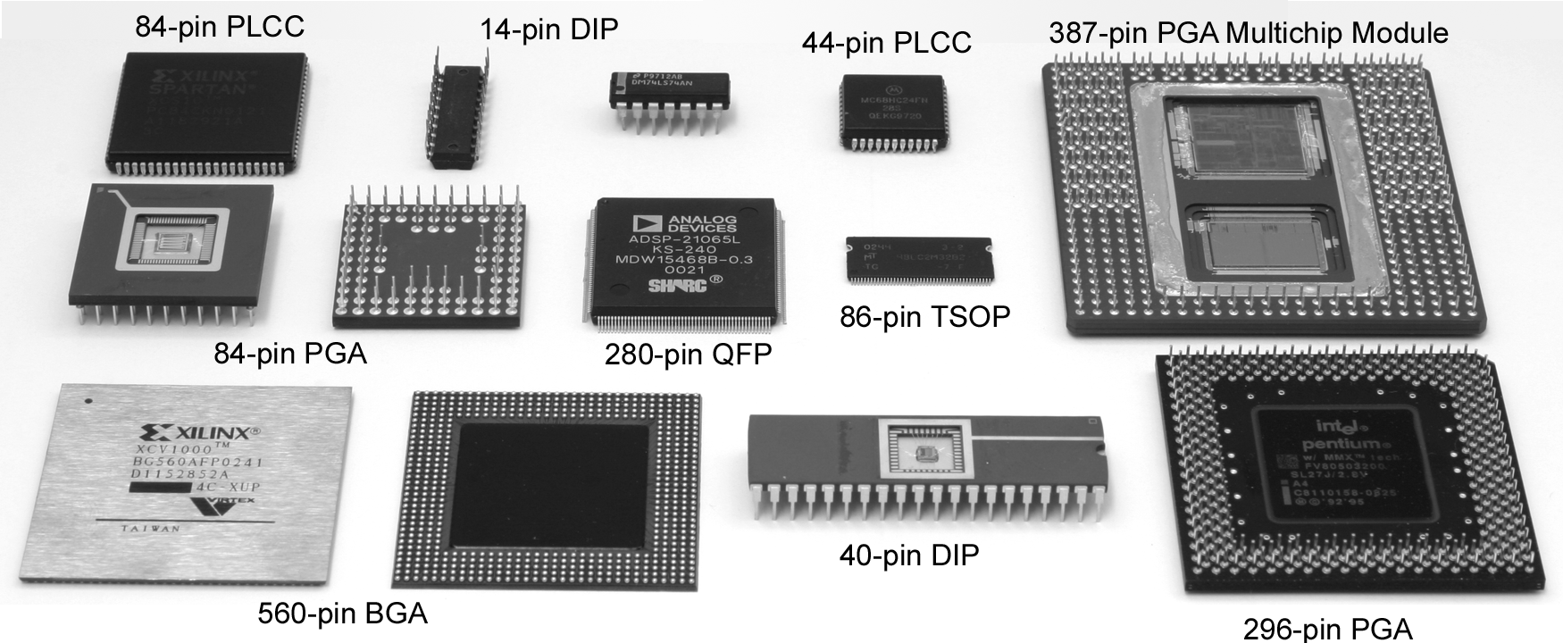
Package Types
Through-hole vs. surface mount
From Adnan Aziz http://www.ece.utexas.edu/~adnan/vlsi-05/

Slide 10
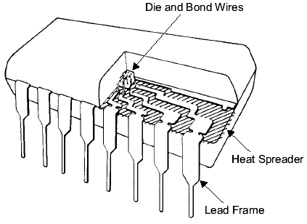
Chip-to-Package Bonding
Traditionally, chip is surrounded by pad frame
Metal pads on 100 – 200 μm pitch
Gold bond wires attach pads to package
Lead frame distributes signals in package
Metal heat spreader helps with cooling
From Adnan Aziz http://www.ece.utexas.edu/~adnan/vlsi-05/

Slide 11
Advanced Packages
Bond wires contribute parasitic inductance
Fancy packages have many signal, power layers
Like tiny printed circuit boards
Flip-chip places connections across surface of die rather than around periphery
Top level metal pads covered with solder balls
Chip flips upside down
Carefully aligned to package (done blind!)
Heated to melt balls
Also called C4 (Controlled Collapse Chip Connection)
From Adnan Aziz http://www.ece.utexas.edu/~adnan/vlsi-05/

Slide 12
Package Parasitics
Use many V_{DD}, GND in parallel
Inductance, I_{DD}
From Adnan Aziz http://www.ece.utexas.edu/~adnan/vlsi-05/

Slide 13
Signal Interface
Transfer of IC signals to PCB
Package inductance.
PCB wire capacitance.
L - C resonator circuit generating oscillations.
Transmission line effects may generate reflections
Cross-talk via mutual inductance
L-C Oscillation
Chip
PCB trace
f =1/(2π(LC)^{1/2})
L = 10 nH
C = 10 pF
f = ~500MHz
L
Z
C
R
Transmission line reflections
Package

Slide 14
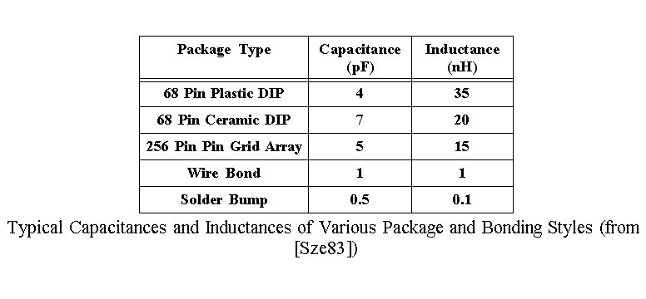
Package Parameters

Slide 15
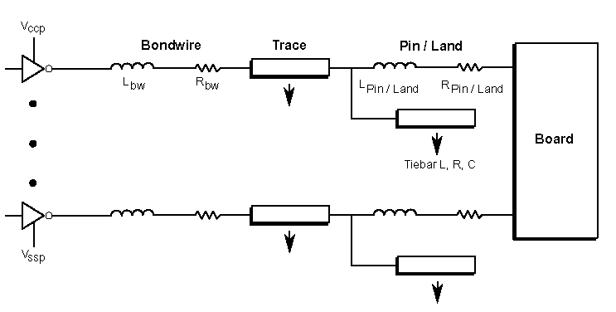
Package Parameters

Slide 16
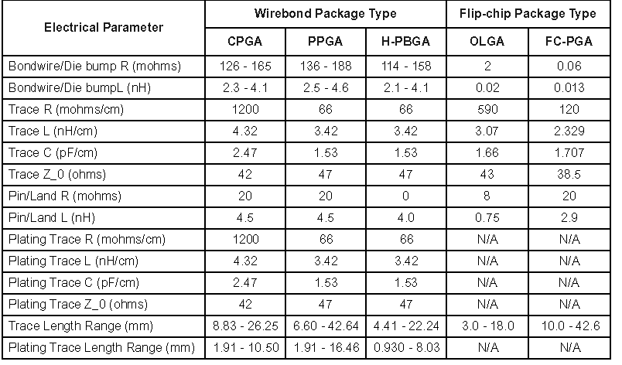
Package Parameters
2000 Summary of Intel’s Package I/O Lead Electrical Parasitics for Multilayer Packages

Slide 17
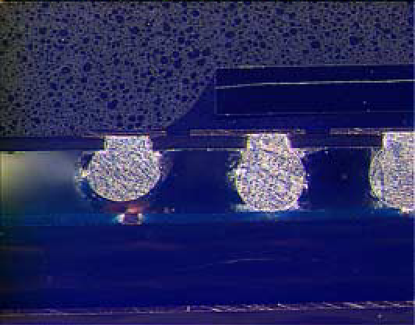
Packaging Faults
Small Ball Chip Scale Packages (CSP) Open

Slide 18
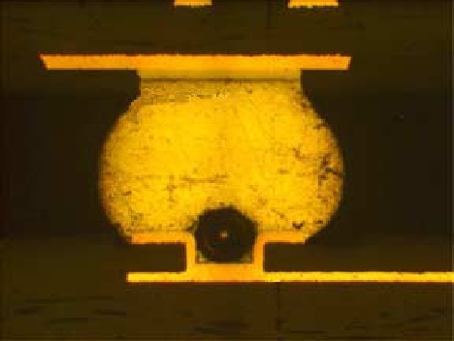
Packaging Faults
CSP Assembly on 6 mil Via in 12 mil pad
Void over via structure

Slide 19
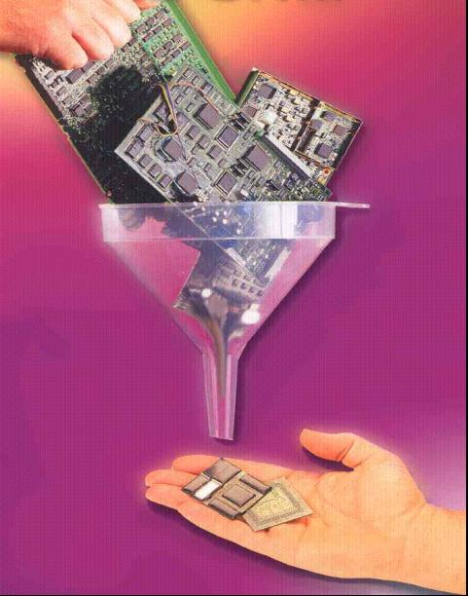
Miniaturisation of Electronic Systems
Enabling Technologies :
SOC
High Density Interconnection technologies
SIP – “System-in-a-package”
From ECE 407/507 University of Arizona
http://www.ece.arizona.edu/mailman/listinfo/ece407

Slide 20
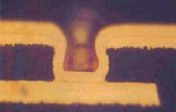
The Interconnection gap
Improvement in density of standard interconnection and packaging technologies is much slower than the IC trends
PCB scaling
Advanced PCB
Size scaling
Laser via
Interconnect Gap
IC scaling
Time
From ECE 407/507 University of Arizona
http://www.ece.arizona.edu/mailman/listinfo/ece407

Slide 21
The Interconnection gap
Requires new high density Interconnect technologies
PCB scaling
Advanced PCB
Size scaling
Thin film lithography based
Interconnect technology
IC scaling
Reduced Gap
Time
From ECE 407/507 University of Arizona
http://www.ece.arizona.edu/mailman/listinfo/ece407

Slide 22
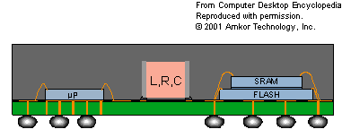
SoC has to overcome…
Technical Challenges:
Increased System Complexity.
Integration of heterogeneous IC technologies.
Lack of design and test methodologies.
Business Challenges:
Long Design and test cycles
High risk investment
Hence time to market.
Solution
System-in-a-Package
From ECE 407/507 University of Arizona
http://www.ece.arizona.edu/mailman/listinfo/ece407

Slide 23
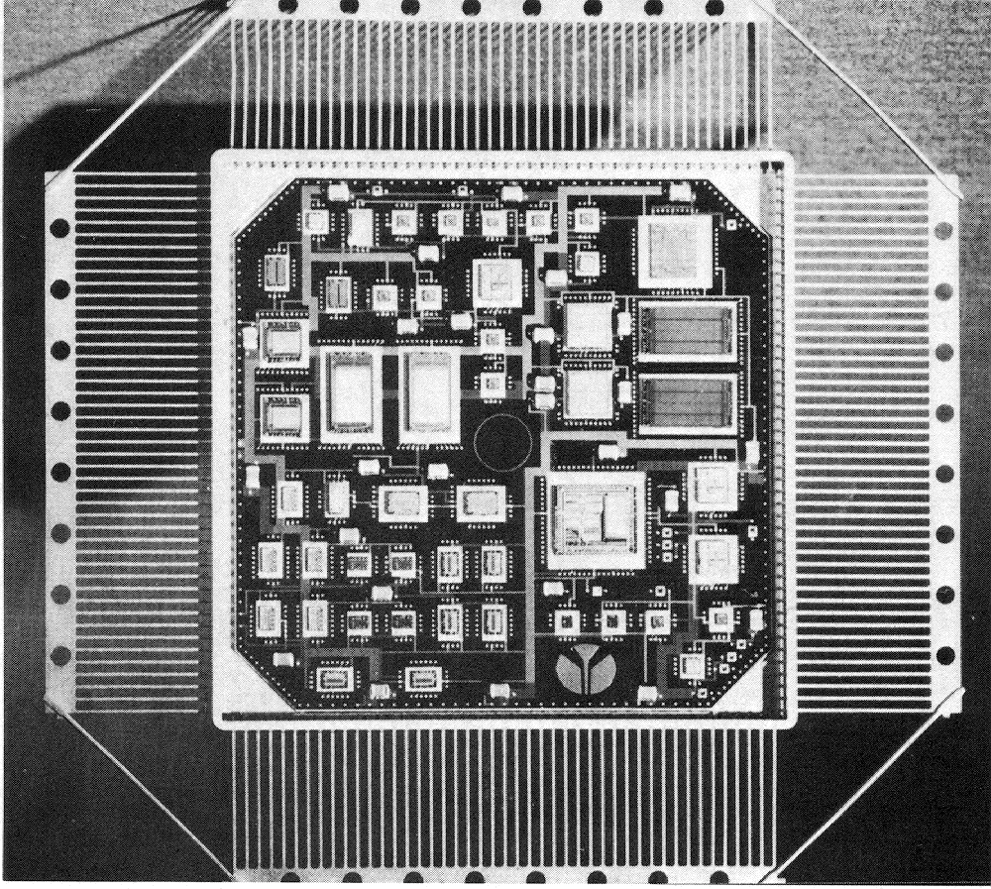
Multi-Chip Modules

Slide 24
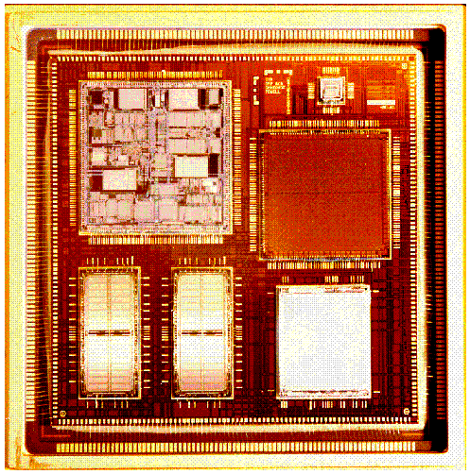
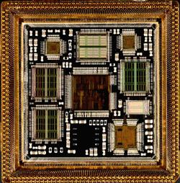
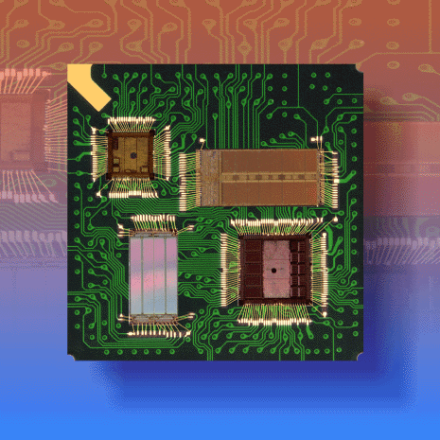
Multiple Chip Module (MCM)
Increase integration level of system (smaller size)
Decrease loading of external signals > higher performance
No packaging of individual chips
Problems with known good die:
Single chip fault coverage: 95%
MCM yield with 10 chips: (0.95)¹⁰ = 60%
Problems with cooling
Still expensive

Slide 25
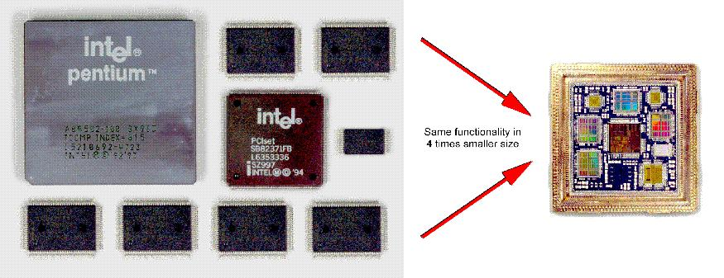
Complete PC in MCM

