Slide 1
EE 314: Basic EE II
Midterm Solutions

Slide 2
Problem 1
What makes a material a semiconductor? What are dopants?
A semiconductor acts as an insulator at very low temperatures and as a conductor at very high temperature. It has 4 valence electrons.
Dopants are added to increase the conductivity of a semiconductor. P- type (has 3 valence electrons) and N-type (has 5 valence electrons).
What are N-channel transistors and P-channel transistors? What role does the gate electrode play?
An N-Channel transistor has two heavily doped n+ regions (Source and Drain) separated by a lightly doped p-substrate. A positive gate voltage drives holes in the p-substrate away from the gate and attracts electrons, forming n-channel under the gate oxide.
An P-channel transistor is similar but with p+ Source and Drain separated by n-substrate. A negative gate to source voltage is needed to turn on the transistor (form p-channel).
Gate voltage can lead to the formation of the channel, thus the gate electrode can be used to turn transistor on or off .

Slide 3
Problem 1
Describe how nanotechnology can help to localize cancer cells.
Nano sized gold particles coated with enzymes can be injected into the blood steam. The enzymes are so designed that they only adhere to cancer cells .
These enzymes can either attack and destroy the cancer cells or help in detection and location of the cells.
How does a solar cell works?
A solar cell is similar to an LED. Solar cell excited by light to force electric current whereas an LED uses electric current to emit light.
Light shining on a PN junction provides sufficient energy to electrons in the valence band so that they can move to conduction band, thus generating electricity.

Slide 4
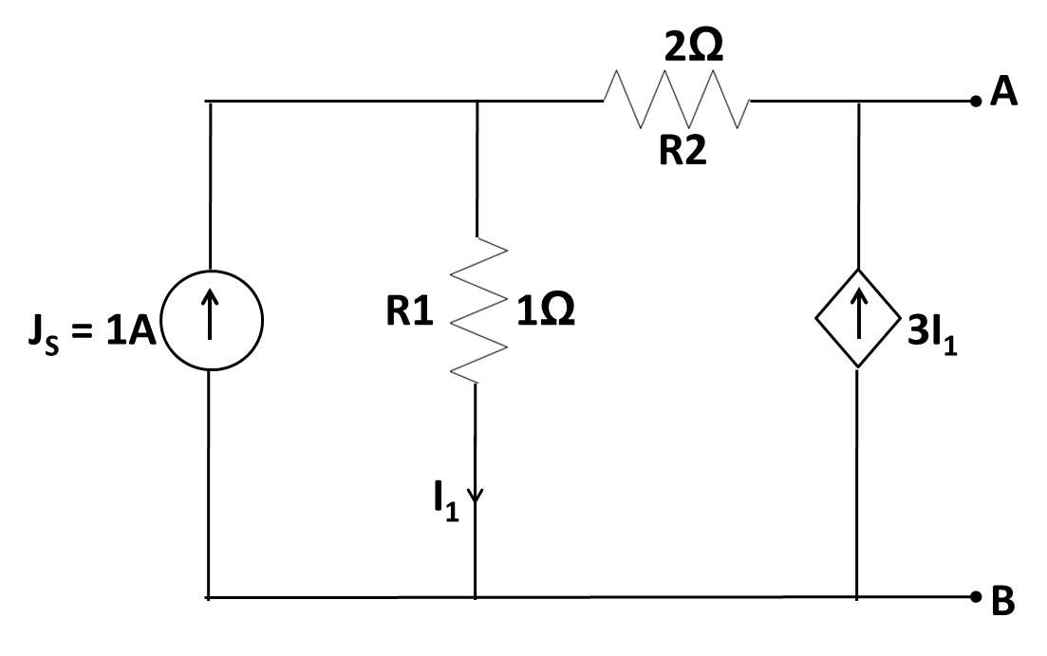
Problem 2: Determine the Thevenin equivalent circuit between terminals A and B for the circuit shown in Fig. 2 below.
N1
+
V_{O}
-
Consider the open circuit case: -
Applying KCL at node ‘N1’
$1=I_{1}−3I_{1}=−2I_{1} \underset{⇒}{}{ I}_{1}=−\frac{1}{2}$ [A]
Find the open –circuit voltage V_{O}: -
$V_{O}=I_{1}R_{1}+3I_{1}R_{2}=−\frac{1}{2}−\frac{3}{2}∗2\underset{⇒}{}V_{O}=−3\frac{1}{2}[V]=V_{th}$

Slide 5
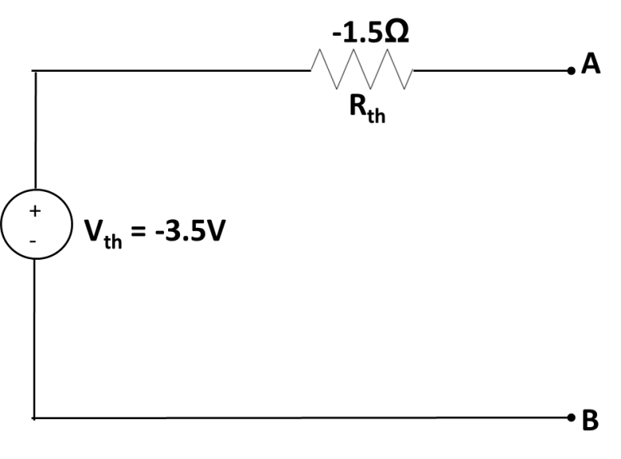
Problem 2: Contd.
+
V₁
-
N1
N2
+
V₁
I_{O}
-
Consider the short circuit case: -
Applying KCL at node ‘N1’
$1=\frac{V_{1}}{1}+\frac{V_{1}}{2}=\frac{3}{2}V_{1} \underset{⇒}{}{ V}_{1}=\frac{2}{3}[V] \underset{⇒}{}{ I}_{1}=\frac{V}{1}=\frac{2}{3}[A]$
Find the short –circuit current I_{O} (KCL at node ‘N2’):
$I_{O}=3I_{1}+\frac{V_{1}}{2}=2+\frac{1}{3}=2\frac{1}{3}$
Thevenin equivalent resistance:
$$R_{th}=\frac{V_{O}}{I_{O}}=−\frac{7}{2}∗\frac{3}{7}=−\frac{3}{2}Ω$$

Slide 6
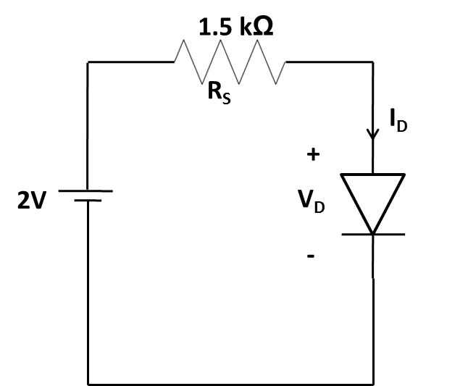
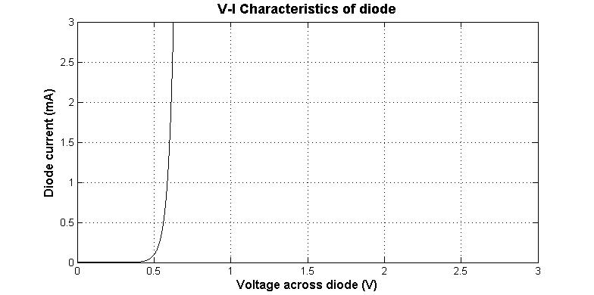
Problem 3: Use load-line analysis to determine I_{D} and V_{D} values for the circuit in Fig. 3(a). The diode characteristic is shown in Fig. 3(b) below.
V = I_{D}R_{S} + V_{D} => 2 = I_{D}*1.5k + V_{D}
Load Line:
If V_{D} = 0, I_{D} = 1.33mA
If I_{D} = 0, V_{D} = 2V
Operating point is intersection of characteristic and load line.
Hence
V_{D} = 0.575V
I_{D} = 0.95mA
I_{D}
V_{D}

Slide 7
Problem 2: Alternative way to find Thevenin resistance.
N1
N2
+
I_{x}
V_{x}
-
Consider the open circuit case: -
Applying KCL at node ‘N2’
$Ix=I_{1}−3I_{1}=−2I_{1}$
Applying KVL : -
$$V_{x}=I_{1}{(R}_{1}+R_{2})=3I_{1}\underset{⇒}{}{ R}_{th}=\frac{V_{x}}{I_{x}}=\frac{3I_{1}}{−2I_{1}}=−\frac{3}{2}Ω$$

